Slide 1
Demystifying the energy market
James Hyatt
Advisor, Australian Energy Market Commission
Retail and wholesale markets team
31 October 2019

Slide 2
Outline
1. | National governments and energy policy development
2. | Market body roles
3. | Role of the AEMC
4. | National objectives for electricity, gas and energy retail
5. | AEMC rule making process and work program
6. | Lowest cost solutions through stakeholder engagement
7. | AEMC retail market team’s work program
8. | Example: hardship rule change

Slide 3
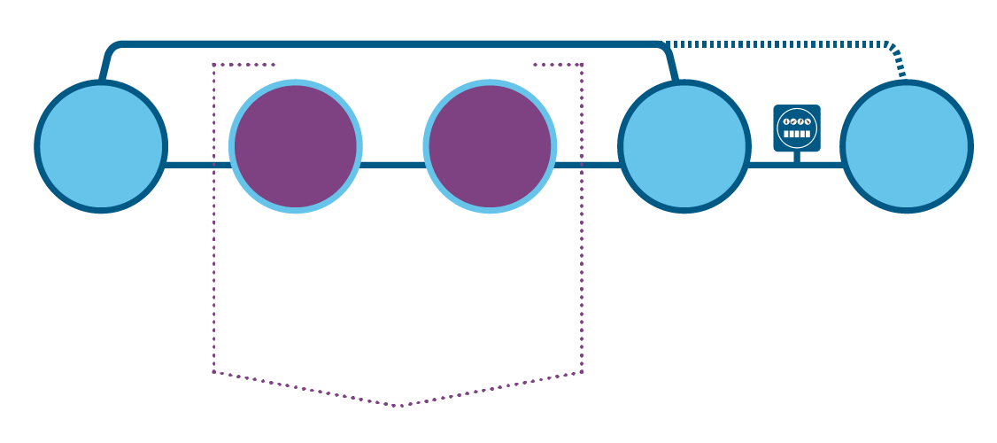
NEM market design
WHOLESALE MARKET (Generators sell their power to retailers)
RETAIL MARKET
NATURAL MONOPOLIES
METER
ELECTRICITY SUPPLY CHAIN
ELECTRICITY GENERATION
TRANSMISSION NETWORK
DISTRIBUTION
RETAILER
CONSUMERS
More consumers are buying and selling power
NETWORK REGULATION
The rules enable the regulator to set the maximum prices network business can charge for services they provide. Prices are set every five years.
AEMC MAKES THE RULES
RULES
AUSTRALIAN ENERGY REGULATOR (AER) APPLIES THE RULES
Natural Monopoly Sector Component
46.5%
Competitive Sector Component
53.5%
Based on the average NSW residential bill in 2017/2018. Source: AEMC Price Trends 2018

Slide 4
National governments and energy policy development
COAG Energy Council
COAG
ESB
Council of Australian Governments (COAG) implements policy reforms of national significance that require cooperative action by federal, state and territory governments
COAG Energy Council is made up of the nation’s energy ministers. They provide national leadership on energy market development which is so important for the health of the national economy
Energy Security Board was established by the COAG Energy Council to coordinate implementation of recommendations from the independent review into the future security of the national electricity market (Finkel review)
The board is comprised of an independent Chair and Deputy Chair and the most senior leaders of the AEMC, AER and AEMO.

Slide 5
Market body roles
AEMC
AER
AEMO
Australian Energy Market Commission Rule maker, market developer and expert adviser to governments
Protects consumers and achieves the right trade-off between cost, reliability and security.
Australian Energy Regulator Economic regulation and rules compliance
Polices the system and monitors the market.
Australian Energy Market Operator Electricity and gas systems and market operator
Works with industry to keep the lights on.

Slide 6
National objectives for electricity, gas and energy retail
“…to promote efficient investment in, and efficient operation and use of, electricity [or natural gas or energy retail] services for the long term interests of consumers with respect to price, quality, safety, reliability and security of supply…”

Slide 7
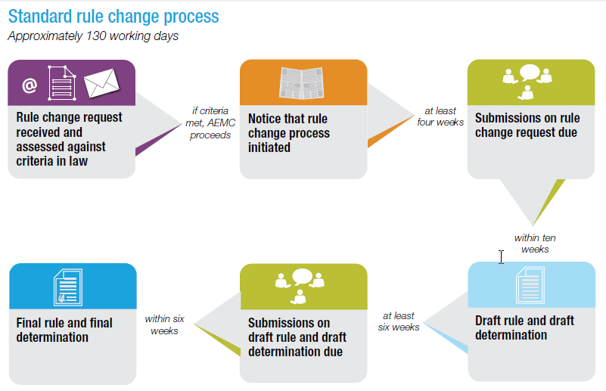
AEMC rule making process
Anyone (except the AEMC) can submit a rule change request.
Every rule change request must be considered by the Commission.
We consult with stakeholders to come up with least-cost solutions to address issues in the energy sector.
*fast-track and expedited rule change processes are quicker than the standard process.

Slide 8
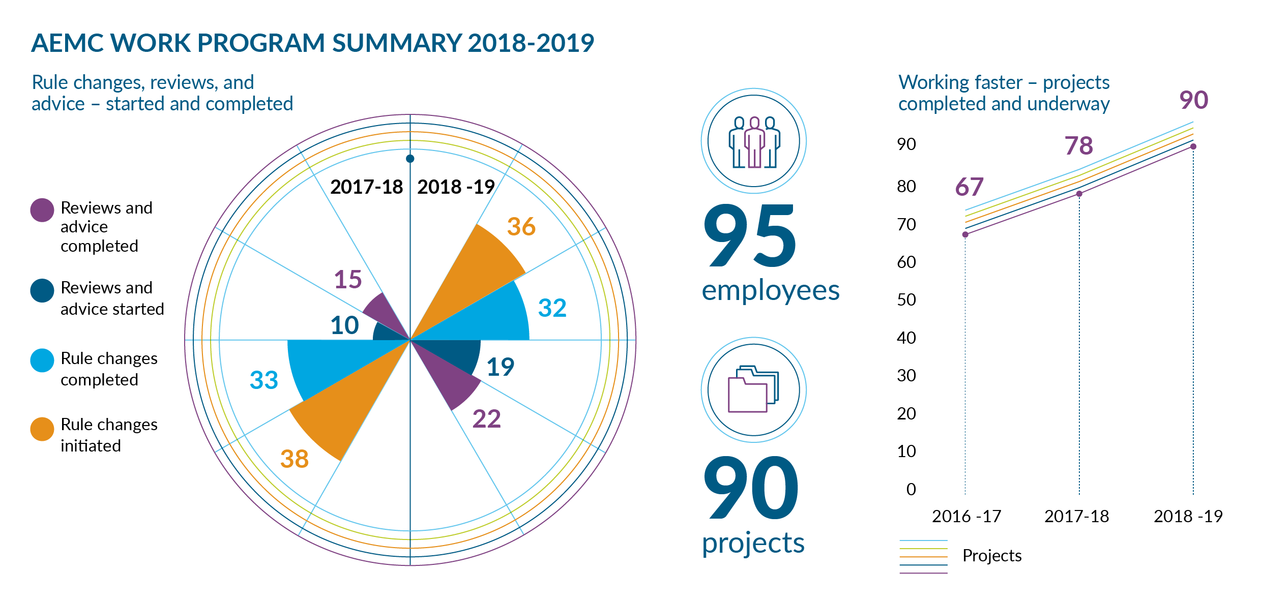
AEMC work program summary 2018-19

Slide 9
AEMC’s forward work program – 5 priority areas of regulatory reform
1. | Generator access and transmission pricing |  | Shift from large geographically concentrated to small geographically dispersed generation
2. | System security |  | Services previously provided for free not necessarily provided by new generation
3. | Integrating distributed energy resources |  | Increased adoption of small-scale solar and energy storage technologies
4. | Digitalisation of energy supply |  | Increased adoption of digital technologies
5. | Aligning financial incentives with the physical needs |  | More variable demand and supply creating volatility

Slide 10
AEMC’s experience in retail energy competition
Our experience of greater retail competition in other states is:
Benefits of competition are that it:
generally lowers prices for consumers
provides more choice for consumers
Risks and drawbacks of competition generally associated with poor retailer behaviour.
Our retail work program is based around trying to maximise the benefits of competition and minimise (or remove where possible) the risks of competition.

Slide 11
Retail energy competition review and Tasmania
Each year the AEMC conducts the Retail energy competition review, which assesses the state of retail energy market competition in most Australian states, including Tasmania.
The review looks at whether the long term interests of consumers are being served and makes recommendations where improvements can be made.
In 2020, in addition to our usual assessment of retail competition, our review will include analysis of:
the current consumer protections framework
innovation in the retail market for electric vehicles customers.

Slide 12
Choice, control and protection for consumers
Our work aims to help deliver more affordable energy by giving consumers more control over their energy bills.
Examples of recent rules aimed at putting consumers in the driver's seat:
Reducing customers’ switching times
Preventing discounts on inflated energy rates
Notification of end of fixed benefit period
Advance notice of price changes
Regulating conditional discounts

Slide 13
Strengthening protections for customers in hardship – rule change
This rule change project allowed the Australian Energy Regulator to introduce binding hardship guidelines.
These guidelines make sure retailers’ hardship policies are clear and consistent in explaining what they will do to support hardship customers.
Customers can better understand their rights and more easily get the help they need to pay their power bills as a result.
The Australian Energy Regulator has approved 1st Energy and Aurora’s updated and improved hardship guidelines, which are now being used by these retailers to assist suitable Tasmanian residential electricity customers.

Slide 14
We have a unique system in Australia where anyone, any company, government, advocacy group or individual person, can propose a change to the rules.
Collaboration is the key to success as it will deliver workable and lasting change.

Slide 15
Questions?
For more information visit www.aemc.gov.au
To receive AEMC news updates and announcements by email register via www.aemc.gov.au/news-centre

Slide 16
Office address Level 6, 201 Elizabeth Street Sydney NSW 2000
ABN: 49 236 270 144
Postal address PO Box A2449 Sydney South NSW 1235
T (02) 8296 7800 F (02) 8296 7899

