Slide 1


Ethics and Financial Counselling
Navigating Complexity

Slide 2
Objectives for today
What is professional ethics
Understand and be aware of ethical problems, ethical dilemmas and ethical theories
Apply ethical principles, decision-making frameworks to solve dilemmas
Why it is important to study ethical theories
What are the main ethical theories
Explain the Kohlberg theory of moral reasoning
Explore the link to the Code of ethics for Financial Counselors (FCA, 2012)

Slide 3
We will start with Ethics and the Individual: You…and then we will move onto the Financial Counselling profession and industry context.
Notes:
Run ‘The Good Place’ Episode 5th Episode of Season 2 of the good place

Slide 4
Train/ Trolley problem Good Place Explanation
https://www.youtube.com/watch?v=vfIdNV22LQM
Notes:
https://www.youtube.com/watch?v=vfIdNV22LQM

Slide 5
Train/ Trolley problem part 2
https://www.youtube.com/watch?v=JWb_svTrcOg
Notes:
https://www.youtube.com/watch?v=JWb_svTrcOg

Slide 6
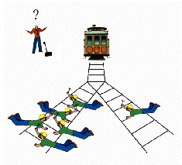
Classic Train example
A runaway train is hurtling down the tracks towards 5 people who will be killed if it proceeds on its present course. You can save these 5 by diverting the train onto a different set of tracks, one that has only 1 person on it, but if you do this that person will be killed.
Q: Should you turn the train to prevent 5 deaths at the cost of 1?
Notes:
What do you do? Do you do anything? If so what and why?
Your decision what is based on? Principles/consequences of action?
What is the rational behind your decision?
What if you knew the one person? Or is it a family member?

Slide 7
What is Professional ethics?
The application of ethical principles by a professional who has an obligation to those who rely on his/her services
Notes:
Professional ethics involves the UPMOST CARE in the discharge of one’s duties.
Such professional care includes the following:
The exercise of reasonable skills and diligence – you want accountants to be hard working and not to make mistakes when doing your BAS statements or tax returns.
Adherence to professional statements and standards–
The cautious application of relevant knowledge and experience – for example, their university knowledge or professional development – must be used it appropriately
Apply Professional scepticism - to ensure that any observed discrepancies are properly Followed up and investigated -

Slide 8
What is Professional ethics?
The exercise of reasonable skills and diligence – you want accountants to be hard working and not to make mistakes when doing your BAS statements or tax returns.
Adherence to professional statements and standards– Financial Counselling Code of Ethics 2012
The cautious application of relevant knowledge and experience – for example, their university knowledge or professional development – must be used it appropriately
Apply Professional scepticism - to ensure that any observed discrepancies are properly Followed up and investigated -

Slide 9
The Concept of a Profession
A Systematic Body of Theory
Professional Authority
Community Sanction
Ethical Codes
Professional Culture
For example a Financial Counsellor!!
Counselling and Financial standards/theory is required to prepare statement financial position and to navigate the process
FCA, FCAT, etc
Notes:
For example an accountant!!
Accounting standards/theory is required to prepare financial statements
CPA , CA, IFA etc

Slide 10
What are ethics?
Ethics can be defined broadly as
a set of moral principles or values
Each of us has such a set of values
We may or may not have
considered them explicitly
Notes:
The word ethics comes from the greek word ethicos.
Which is about character.
There are many different definitions for Ethics but,
ethics can be defined broadly ………………………
These moral principles or values are used to determine as to what is right or wrong.
The term ethics has also been defined “as being the study and philosophy of human conduct, with an emphasis of determining right and wrong.
So in summary it can be said that :
“Ethics evaluates human actions a to whether they are right or wrong”

Slide 11
The word ethics comes from the greek word ethicos.
Which is about character.
There are many different definitions for Ethics but, ethics can be defined broadly ………………………
These moral principles or values are used to determine as to what is right or wrong.
The term ethics has also been defined as being the study and philosophy of human conduct, with an emphasis of determining right and wrong.
So in summary it can be said that :
Ethics evaluates human actions as to whether they are right or wrong
Notes:
Do youtube here next slide

Slide 12
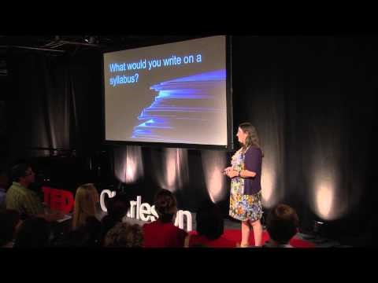
Why Not Cheat? How Our Ethics Alters Our Happiness: Jennifer Baker at TEDxCharleston
Notes:
https://www.youtube.com/watch?v=ubGOBvTPRjw

Slide 13
Why do we need ethics?
Ethical behaviour is necessary for a society
to function in an orderly manner
The need for ethics in society is sufficiently
important that many commonly held
ethical values are incorporated into laws
Notes:
Why do we need ethics or ethical behaviour in society?
When developing new laws usually ethical principles are incorporated into the law
For example stealing – Is it right to take someone else’s belongings against their will?
we all know that the action of stealing is an illegal activity – because there is a law against it.
Is it wrong or unethical? Yes or no?
BUT, what about when you need to steal food to feed your family and to survive????
Is it wrong then??
It is still illegal / what about ethical?
It depends how you look at the situation and what ethical theory you use to assess the action (Deontological/teleological)
At the end of the day,
The Laws of society CANNOT include all the different morals of all the people, and to make up laws is a time consuming process.
So with the case of stealing: Some people still do it.
Why do people behave unethically?

Slide 14
Why do people act unethically?
The person’s ethical standards are different
from those of society as a whole
The person chooses to act selfishly
In many instances, both reasons exist
Notes:
Everyone is different and therefore we all think and act differently
It could be due to Different cultures (individual vs collective societies)
Different values/morals
Different upbringing,
Different Circumstances (financial/emotional etc,)
Education – knowledge/ethics
For eg with bribery Is it unethical / wrong? …. Asia, Middle east, eastern Europe
We live in a individualistic and Capitalist society where materialism /status and /wealth are so important for people to achieve, and sometimes at the cost of acting ethically.
So given these differences in people, when faced with an ethical problem or ethical dilemma
You would expect people to respond differently and for different reasons.
So what is an ethical problem or ethical dilemma and is there a difference???

Slide 15
Everyone is different and therefore we all think and act differently
It could be due to Different cultures (individual vs collective societies)
Different values/morals
Different upbringing,
Different Circumstances (financial/emotional etc,)
Education – knowledge/ethics
For eg with bribery Is it unethical / wrong? …. Asia, Middle east, eastern Europe
We live in a individualistic and Capitalist society where materialism /status and /wealth are so important for people to achieve, and sometimes at the cost of acting ethically.
So given these differences in people, when faced with an ethical problem or ethical dilemma
You would expect people to respond differently and for different reasons.
So what is an ethical problem or ethical dilemma and is there a difference???

Slide 16
Why be ethical? Who cares?
Individuals care
Employees/Managers/executives care
Professions/Industry/Society cares
Notes:
So what is the point of behaving ethically? Ask your self this question and answer/discuss with your group/class
Do you care – as individuals?
Most people are employed,
Can be a manager
Executive
Working for a particular industry
And of course we all belong to a society – how do we want that society to be??
Everyone is different and therefore we all think and act differently

Slide 17
Identify reasons why an organization/ financial counsellor would be interested in being ethical?
Classify those reasons in terms of whether they represent moral motivation or economic motivation.

Slide 18
Ethical Problem
A situation in which you are morally or
ethically required to take action that
conflicts with your immediate
self interest
Notes:
So lets look at some examples of an ethical problem…….next PP

Slide 19
Ethical Problems
Ethical problem 1
You find a briefcase containing important papers and $1,000.
What do you do?
Ethical Problem 2
Your bank incorrectly credits your mortgage account with $10,000.
What do you do?
Ethical Problem 3
Your lecturer makes an input error and gives you a HD for a group
assignment but the rest of the group get a P?
.
What do you do?
Notes:
On a piece of paper write an answer (and reasoning for your answer/why?) to the above problems..
Do you keep the $1000 or do you give in to the police?
Do you tell the bank?? Tell bank because : you are scared of the bank finding out or is it because the $ money is not yours and therefore should tell the bank???
Do you inform your lecturer of the mistake? Y/No, and why?
But the important point here is not just what action you take but also the REASON WHY the rationale for your decision.
The decision you make all depends on many reasons but in particular your level of moral development and reasoning
Your decision can be the same as the person next to you
But the reason behind the decision can be very different,
and we will see this when we look at
Kohlberg’s theory of moral reasoning

Slide 20
On a piece of paper write an answer (and reasoning for your answer/why?) to the above problems..
Do you keep the $1000 or do you give in to the police?
Do you tell the bank?? Tell bank because : you are scared of the bank finding out or is it because the $ money is not yours and therefore should tell the bank???
Do you inform your lecturer of the mistake? Y/No, and why?
But the important point here is not just what action you take but also the REASON WHY the rationale for your decision.
The decision you make all depends on many reasons but in particular your level of moral development and reasoning
Your decision can be the same as the person next to you
But the reason behind the decision can be very different,
and we will see this when we look at Kohlberg’s theory of moral reasoning

Slide 21
Rationalising unethical behaviour
Everyone does it
If it’s legal, it’s ethical
Likelihood of discovery and consequences

Slide 22
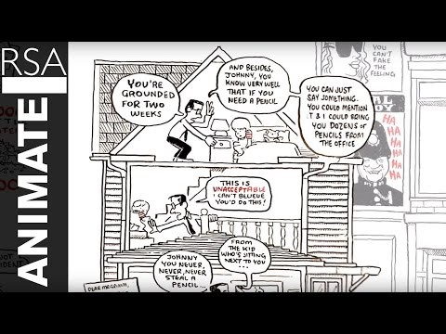
RSA ANIMATE: The Truth About Dishonesty
Notes:
https://www.youtube.com/watch?v=XBmJay_qdNc

Slide 23
Ethical dilemma
A situation in which a decision must
be made in the face of conflicting
moral duties

Slide 24
What is an Ethical Dilemma?
A situation where values are in conflict
  Two or more values you hold dear - or –
  Personal value conflicts with organizational value
Value Value
Notes:
An ethical dilemma arises when there are 2 or more equally and compelling alternative courses of action without a clear resolution.
The conflict could involve 2 or more obligations (work or family),
duties (to the boss/customer),
principles ethical/religious (integrity, confidentiality)
rules or loyalties (boss or colleagues/ one friend over the other.
Similarly each alternative has a positive and a negative outcome.
And Choosing one alternative is at the expense of the other.
So what are some examples of ethical dilemmas….next PP

Slide 25
An ethical dilemma arises when there are 2 or more equally and compelling alternative courses of action without a clear resolution.
The conflict could involve 2 or more obligations (work or family),
duties (to the boss/customer),
principles ethical/religious (integrity, confidentiality)
rules or loyalties (boss or colleagues/ one friend over the other.
Similarly each alternative has a positive and a negative outcome.
And Choosing one alternative is at the expense of the other.
So what are some examples of ethical dilemmas?
Notes:
In regards to the Financial Counselling profession there must be at least two actions from the code of ethics that could be taken and of which any action will negatively impact in some way the situation. Therefore there are no choices in which one part of the code of ethics is not impacted.

Slide 26
Ethical Dilemmas
Ethical Dilemma 1
You are asked by your manager to conduct surveillance on your
co-workers to determine who is using the Internet during working
hours to download music
Ethical Dilemma 2
One of your clients tells you that they are considering
investing in another company to whom you also provide services.
Through your involvement with this company you know that its CEO
is currently being investigated for fraud
Notes:
dilemma 1
What principles or obligations are involved here?
Loyalty, right to know, Invasion of privacy?? Trust? Who are you loyal to ? Boss or your co-workers??
Dilemma 2 – ask students
Confidentiality, integrity, honest good advice, right to know???

Slide 27
Ethical Dilemmas
Ethical Dilemmas
What are some Financial Counselling Ethical Dilemmas you can think off?
Notes:
dilemma 1
What principles or obligations are involved here?
Loyalty, right to know, Invasion of privacy?? Trust? Who are you loyal to ? Boss or your co-workers??
Dilemma 2 – ask students
Confidentiality, integrity, honest good advice, right to know???

Slide 28
Example
One of your colleagues comes to you and confides in you that they are really struggling with a client and just wish that they would take some responsibility for their actions and behaviours as they are frustrated with continually having to assist them with their finances. They know that they have mental health issues but because they’ve displayed a level of functioning in appointments they believe they have capacity to make decisions and take more ownership of the issues. They express that they have so much work to do and not enough time to keep assisting them so they will do the minimum to assist them as nothing seems to work with them. You express your care and concern for them as a worker but suggest that reflecting on their own reactions may be helpful as it could be impacting their ability to assist their client. The worker says that it’s not about them and they’re fine it’s the client and thanks you for listening and say’s we’ve all got clients like this.
What do you do?
Notes:
Professional Integrity section 5 of the FCA code of ethics.
Working in the client’s best interests.

Slide 29
Why Bother Talking about Ethics?
Helps practitioners to detect issues more perceptively and understand the reasons for acting ethically.
Help prevent, detect and deter fraudulent reporting (Treadway Commission 1987)².
Value shaping is a contentious issue and ethics education is unlikely to convert a deviant human being.
Notes:
Good character isn’t always enough
Adults develop moral judgment into their 30s
Conduct is influenced by environment
Moral awareness – you need to develop the knowledge and skills to become aware and sensitive to issues.
And hopefully it can lead to ethical judgment and behaviour

Slide 30
Why study Ethics?
Conflicting principles may lead to difficulties in determining what is right
Identify basic principles that can be applied to action
Help develop ethical reasoning skills to assist with ethical dilemmas
Individuals may hold inadequate beliefs and applying them to dilemma examples may reveal the inadequacy of these beliefs
Understand whether and why opinions are worth holding.
Understand the rationale behind decision-making
What should be done and why?
Have a checklist of questions to ask yourself to determine what the outcome should be.
Notes:
As we get older, more educated and the world becomes more global (distance is not a problem – everything is closer)
Well, our values evolve and need to change to fit in with today’s culture and society’s values and needs?? Think about what our parents thought about…….Caring for the environment, gender equality, discrimination, race, colour of our skin,
differences in culture – cultural sensitivity etc
Socrates philosophised that the unexamined life is not worth living?? Do you reflect about your values, goals and generally the way you live your life? What is more important family or work- what about if they conflict?

Slide 31
What guides what we do?
Where do you draw from to determine what you do when working with people?
What guides you?
What do you draw from in your training and qualifications?
What do you transfer into your practice and role?
What are the current beliefs and values that may be influencing or impacting on your practice and work?

Slide 32
CHARACTERISTICS OF INDIVIDUALS
Individual Differences
Cognitive Biases
  Process of Individual Ethical Decision-Making Behavior
MORAL
AWARENESS
ETHICAL
JUDGMENT
ETHICAL
BEHAVIOR
CHARACTERISTICS OF ORGANIZATIONS
Group and Organizational Pressures
Organizational Culture

Slide 33
Your Personal Practice Framework
Professional/ Practice Skills | Professional Knowledge | Theory & Research
Cultural Practice Communication skills Micro skills Interpersonal skills Reflection skills Awareness of self Awareness and use of power Self-care strategies Respectful boundaries | Legislation Knowledge of the industry Reading Training Professional & personal lived experience Conferences Policy & procedures | Qualifications & training Philosophy Theories
Beliefs/Values | Professional Identity | Organisational Context
Beliefs and values about : Humanity Culture Gender Identity Fairness and justice Religion, world view, spirituality Society -values, norms, politics What do we believe about people whose behaviour we find disgusting? The use of power & control The end justifies the means? | Attributes Behaviours Language framework Professional development Professional membership | Values & Mission Organisational Structure Culture Funding Legislation Policies & procedures Staff group & team dynamics

Slide 35
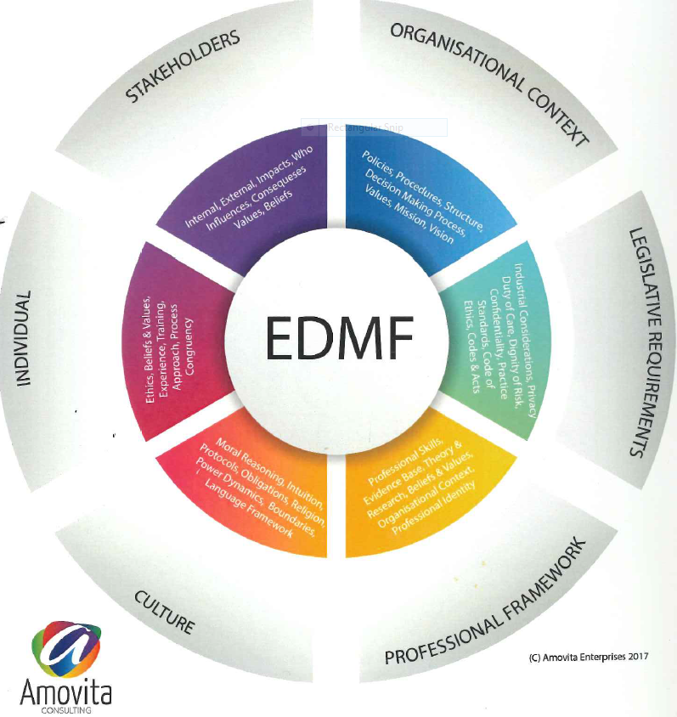

Slide 36
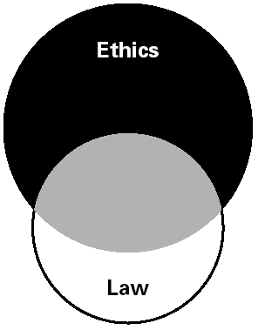
Relationship Between Ethics and the Law
Notes:
If following the law was enough – there would be no use for an ethics course....Being ethical is not always the same as following the law. Simple example whilst being married and having an affair??
The law often incorporates ethical standards to which most citizens subscribe. But laws, like feelings, can deviate from what is ethical. Pollution laws
For example what can we say about ....
Our own pre-Civil War slavery laws,
White person law in Australia,
Women not allowed to vote!! Getting less wages because they are female??
The old apartheid laws of present-day South Africa are obvious examples of laws that deviate from what is ethical and needed to be changed!!

Slide 37
Organisation
Participant Customer
Financial Counsellor

Slide 38
Participants
Financial Counsellor
Organisation's vision and mission, policies
Stakeholders internal, external, values, beliefs
Funding Body
Legisliative requirments and bodies
Others

Slide 39
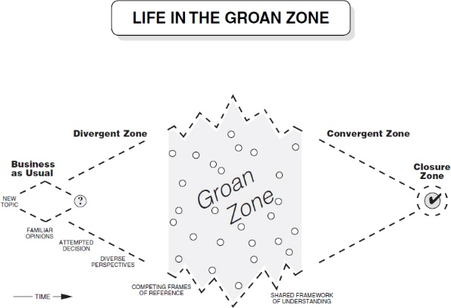
Values-led business goes beyond the rules: Spirit not just letter - FSA

Slide 40
American Accounting Association (AAA) Model for Resolving Ethical Dilemmas
1. Determine the facts
2. Define the ethical issue
3. Identify the major principles, rules and values
4. Specify the alternatives
5. Compare alternatives
6. Assess the consequence of each alternative
7. Make a decision
Notes:
What are the facts of the case – as much information as possible
Who are the stakeholders involved. Ethical issues will arise out of conflicting interests between and among the stakeholders. Who are you loyal to ? Whose integrity is more important? Integrity over loyalty?
Right to know, integrity, loyalty, job security fairness, justice
The Different options available – solutions to the problem .what do you do?
Compare this different solutions and the consequences of these alternatives
Assess the consequences of each of the actions –for eg if you do nothing about unethical behaviour / whisteblowing / inform union officials
Take action of your choice…..
A researcher named Rest, concluded that individuals, as well as having moral values
they must also have perseverance, ego strength and implementation skills to follow
through with their intentions.
One may know what is the right thing to do but to actually go ahead and do it one needs strength of character!

Slide 41
Why study Ethical theories?
help to explain why a person believes that one action is right or wrong.
To understand and analyse how people make ethical decisions.

Slide 42
Normative ethical theories: A concept map
Normative Ethical Theories
Teleological
(Consequences)
Deontological
(Duties)
Notes:
This concept maps show the two main areas of thought.
Consequential and non-consequential theories
Utilitarianism principle ethics (rights and justice theories)

Slide 43
Normative theories on ethics
A value judgement on what a person should do rather than what they probably will do
They serve as a criteria for judging the ethics of a situation
They provide a philosophical approach for making ethical decisions

Slide 44
What is a normative theory?
A normative theory is represented by a value judgment on what ‘should’ or ‘ought’ to happen.
normative theories aim to determine what ought to be done.
Example of normative theories – utilitarianism, principles theories and in accounting is triple bottom line (TBL) reporting
TBL reports show the performance of entities in economic, social and environmental matters including costs such as community activities, wastage, pollution and energy emission.

Slide 45
Prescriptive Approaches
Focus on consequences (consequentialist theories)
Focus on duties, obligations, principles (deontological theories)
Focus on integrity (virtue ethics)
Notes:
The 3 main approaches that we will focus on are .......

Slide 46
Focus on consequences – classic Train/Trolley example
A runaway train is hurtling down the tracks toward 5 people who will be killed if it proceeds on its present course. You can save these 5 by diverting the trolley onto a different set of tracks, one that has only 1 person on it, but if you do this that person will be killed.
Notes:
Should you turn the trolley to prevent 5 deaths at the cost of 1?
What are my ethical duties, obligations?
Have I treated others as I would want to be treated? (Goldn Rule)
If everyone behaved this way, would that be acceptable? Would I want to live in that world? (Kant’s categorical imperative)
What would be a fair action if identities were unknown? (Rawls’ veil of ignorance)

Slide 47
Teleological ethics
The word ‘teleological’ comes from the Greek telos, meaning ‘end’.
Teleological theories decide whether behaviour is good or bad (ethical or unethical) by looking at the consequences of that behaviour – behaviour is ‘ethical’ if it results in desirable consequences. Discussion of this class of theories revolves around two issues. The first is to agree on what is a good or desirable consequence and the second is to agree on whose point of view should be adopted in judging behaviour.

Slide 48
Focus on Consequences
(Consequentialist Theories)
Utilitarianism - best known consequentialist theory
Identify alternative actions and consequences to stakeholders
Best decision yields greatest net benefits to society
Worst decision yields greatest net harms to society
Notes:
The word ‘teleological’ comes from the Greek telos, meaning ‘end’.
Teleological theories decide whether behaviour is good or bad (ethical or unethical) by looking at the consequences of that behaviour – behaviour is ‘ethical’ if it results in desirable consequences. Discussion of this class of theories revolves around two issues. The first is to agree on what is a good or desirable consequence and the second is to agree on whose point of view should be adopted in judging behaviour.
We considerAccording to the Utilitarian principle, a decision is ethical if it provides greater net utility than any other decision. A decision is ethical if it produces the greatest good for the greatest number. So provided the action results in the desired consequence then it is right. (Multinational companies use low cost labour in developing countries – good for business and customers)
The ends justify the means.
With Utilitarianism, the intent is to achieve the greatest good for the greatest number – which is fine as long as all stakeholders are recognised.
Measurement / forecasting problems – how does one measure the consequence before it happens??
Forward looking – moral theory

Slide 49
Utilitarian principle
According to the Utilitarian principle, a decision is ethical if it provides greater net utility than any other decision. A decision is ethical if it produces the greatest good for the greatest number. So provided the action results in the desired consequence then it is right. (Multinational companies use low cost labour in developing countries – good for business and customers)
The ends justify the means.

Slide 50
Utilitarianism
With Utilitarianism, the intent is to achieve the greatest good for the greatest number – which is fine as long as all stakeholders are recognised.
The greatest happiness principle meant that an individual should act not to maximise personal utility, but the utility of the community as a whole.
In its extreme form, ethical universalism would accept an individual being killed to save the lives of many others. Although the individual who was killed suffered a considerable loss of utility, the increase in the utility of those who survived more than compensated for that loss

Slide 51
Utilitarianism
(Consequentialist Theories)
Utilitarianism defines ‘good’ as ‘utility’,
which is any source of pleasure, happiness, benefit, good or advantage, or any means of prevention
of pain, evil and unhappiness. These sources of good can be summed to give a measure of utility.
Utilitarianism - best known consequentialist theory
Identify alternative actions and consequences to stakeholders
ethical behaviour that which provided the greatest good to the greatest number.
Greatest happiness principle - an individual should act not to maximise personal utility, but the utility of the community as a whole.
Best decision yields greatest net benefits to society
Worst decision yields greatest net harms to society
Notes:
The greatest happiness principle meant that an individual should act not to maximise personal utility, but the utility of the community as a whole.
In its extreme form, ethical universalism would accept an individual being killed to save the lives of many others. Although the individual who was killed suffered a considerable loss of utility, the increase in the utility of those who survived more than compensated for that loss

Slide 52
Applying the utility principle
Define the problem
  Identify the stakeholders - Immediate, distant?
List the alternative courses of action that you can take
Identify and calculate the short- and long-term costs and benefits
What decision will produce the most benefit (and least harm) for the (stakeholders/clients, profession & industry/creditors) greatest number of people, and for society at large?
Select the course of action that yields the greatest sum of benefits over costs for the greatest number of people.

Slide 53
Example
A client comes in displaying significant anxiety and wants assistance with their legally incurred debts. They have support letters stating their conditions and are on the DSP. They inform you they have suffered abuse and mention that they’ve gone to several news agencies including television providers of current affairs. They state that they can’t afford to pay, however, after conducting a thorough financial assessment and going through their bank statement you discover affordability on their loans. Through the application process and supplying the information one financial institution decides to waive one of the debts however the other one offers a repayment arrangement which they can afford more now. The person having received one debt waiver would like another and emails the CEO of that bank. You get call from a high up boss wanting to deal with the situation and you get the feeling will waive the debt.
What do you do?
Notes:
Professional Integrity section 5 of the FCA code of ethics.
Working in the client’s best interests.

Slide 54
The Layoff
You’re the plant manager in one of ABC Company’s five plants. You’ve worked for the company for 15 years, working your way up from the factory floor after the company sent you to college. Your boss just told you in complete confidence that the company will have to lay off 200 workers. Luckily, your job won’t be affected. But a rumor is circulating in the plant, and one of your workers (an old friend who now works for you) asks the question. “Well, Pat, what’s the word? Is the plant closing? Am I going to lose my job? The closing on our new house is scheduled for next week. I need to know.”What will you say?

Slide 55
Focus on consequences – classic Train/Trolley example
A runaway train is hurtling down the tracks toward 5 people who will be killed if it proceeds on its present course. You can save these 5 by diverting the trolley onto a different set of tracks, one that has only 1 person on it, but if you do this that person will be killed.
Notes:
Should you turn the trolley to prevent 5 deaths at the cost of 1?
What are my ethical duties, obligations?
Have I treated others as I would want to be treated? (Goldn Rule)
If everyone behaved this way, would that be acceptable? Would I want to live in that world? (Kant’s categorical imperative)
What would be a fair action if identities were unknown? (Rawls’ veil of ignorance)

Slide 56
Consequentialist Analysis
Stakeholder | Option 1 - Costs | Option 1 -Benefits | Option 2- Costs | Option 2 - Benefits
#1
#2
#3
#4 ….etc.
Bottom line = action that produces the greatest good for the greatest number of people, for society overall!
Notes:
Can we or should we be able to cost the effects of a decision – in particular if we are costing a life –
How much are you worth??? Discuss this with your group in class

Slide 57
Focus on Consequences
(Consequentialist Theories)
Advantages
  Practical
  Already underlies business thinking
Challenges
  Difficult to evaluate all consequences
  Rights of minorities can be sacrificed

Slide 58
Deontological ethics
The word ‘deontological’ comes from the Greek deon, meaning ‘duty’. Deontological theories are based on duties and rights. In many cases, these duties are set down as rules that must be followed regardless of the circumstances or the consequences.
Duties are activities that a person is expected to perform. Rights are behaviours that a person expects of others. Duties and rights are like two sides of a coin. For example, an accountant has a duty to look after a client’s interests, while the client has a right to the accountant’s best efforts.
Deontological principles – consist of sets of rules. These rules are based on rights or justice and are the guide to ethical decision making.

Slide 59
Focus on Duties, Obligations, Principles (Deontological Theories)
Decisions based upon abstract universal principles: honesty, promise-keeping, fairness, rights, justice, respect
Focus on doing what’s “right” (consistent with these principles) rather than doing what will maximize societal welfare (as in utilitarianism)
Notes:
The word ‘deontological’ comes from the Greek deon, meaning ‘duty’. Deontological theories are based on duties and rights. In many cases, these duties are set down as rules that must be followed regardless of the circumstances or the consequences.
Duties are activities that a person is expected to perform. Rights are behaviours that a person expects of others. Duties and rights are like two sides of a coin. For example, an accountant has a duty to look after a client’s interests, while the client has a right to the accountant’s best efforts.
Deontological principles – consist of sets of rules. These rules are based on rights or justice and are the guide to ethical decision making.
Justice is usually associated with issues of rights, fairness and equality.
Everyone has human rights and everyone has a duty to not violate the right of others. For example, Right to freedom of speech, privacy, safety. Kant developed moral rights with his categorical imperative which states “Act only according to that maxim by which you can at the same time will that it should become universal law” Treat people the way you would like to be treated. Treat people as ends or as a means and ends. Do not use people to just achieve your goals – if you use people (work for you) at least respect them as human beings and to promote their ability to realize their goals.
The process is important. One should behave in accordance with the rules and be consistent and equitable. Backward looking – moral theory.
What the mature person with a good character would deem appropriate is the moral decision. Integrity of character. Known as Virtue ethics

Slide 60
Ethical rules (simplified)
Kant’s categorical imperative (universal rule)
  “What kind of world would it be if everyone behaved this way?” “Would I want to live in that world?”
Rawls’ veil of ignorance – for deciding what’s fair
  “What would your decision be, if decision makers knew nothing about their identities or status?”
Golden Rule
  “Treat others as you would have them treat you” (Assumption is that both parties are ETHICAL! An ethical person wouldn’t expect someone else to be unethical for him/her.)

Slide 61
Social contract
This class of normative ethical theory assumes there is a social contract between the individual and another entity which requires both to perform certain duties and gives to both certain rights.
A ‘social’ contract is an unwritten agreement based on custom and accepted without dissent. Failure to perform the duties implied by the social contract would be unethical behaviour.
Notes:
Entity can be government, a corporation, a profession or another individual.

Slide 62
Deontological Questions
Which values or principles apply?
  Which are most important and why?
What are my ethical duties, obligations?
Have I treated others as I would want to be treated? (Golden Rule)
  Have I assumed that the other(s) is ethical and responsible?
If everyone behaved this way, would that be acceptable?
  Would I want to live in that world? (Kant’s categorical imperative)
What would be a fair action if identities were unknown? (Rawls’ veil of ignorance)

Slide 63
Focus on Duties, Obligations, Principles (Deontological Theories)
Advantages
  Rights approach found in public policy debates (e.g., abortion)
Challenges
  Determining rule, principle, or right to follow: Golden rule, Kant’s maxim
  Deciding which takes precedence
  Reconciling deontological and consequentialist approaches when they conflict

Slide 64
Virtue ethics
Virtue ethics posits that “What is moral in a given situation is what a mature person with good moral character would deem appropriate”.
Integrity as a quality is widely seen as being a trait of a person who is trustworthy - honest, honourable and reliable.
Windal (1990, p. 26) ‘integrity is an element of character and is essential to the maintenance of public trust’.
Courage is an important aspect of integrity.
Integrity without the strength of character to pursue one’ convictions could result in inaction when action is.
Other virtues include – truthfulness, trust, fairness, tolerance, empathy, self-control and civility, moral leadership

Slide 65
For example, a consequentialist may argue that lying is wrong because of the negative consequences produced by lying—though a consequentialist may allow that certain foreseeable consequences might make some lying ("white lies") acceptable. A deontologist might argue that lying is always wrong, regardless of any potential "good" that might come from lying. A virtue ethicist, however, would focus less on lying in any particular instance and instead consider what a decision to tell a lie or not tell a lie said about one's character and moral behavior. As such, the morality of lying would be determined on a case-by-case basis

Slide 66
Focus on Integrity
(Virtue Ethics)
Focus on integrity of moral actor rather than the act
  Considers character, motivations, intentions
  Character defined by one’s community
    Need to identify relevant community
Notes:
Virtue ethics posits that “What is moral in a given situation is what a mature person with good moral character would deem appropriate”.
Integrity as a quality is widely seen as being a trait of a person who is trustworthy - honest, honourable and reliable.
Windal (1990, p. 26) ‘integrity is an element of character and is essential to the maintenance of public trust’.
Courage is an important aspect of integrity.
Integrity without the strength of character to pursue one’ convictions could result in inaction when action is.
Other virtues include – truthfulness, trust, fairness, tolerance, empathy, self-control and civility, moral leadership

Slide 67
Virtue Ethics Questions
What does it mean to be a person of integrity in this situation, profession, etc.?
What ethical community would hold me to the highest ethical standards?
  Do carefully developed community standards exist?
What would the broader community think if this were disclosed? New York Times test?
What would my “harshest moral critic” expect me to do?
What would my “ethical role model” expect?
What do I want my professional reputation to be?

Slide 68
Virtue Ethics –
Management as a Profession
The proposed “Hippocratic Oath”
  Managers as agents of society – serve public interest, enhance long-term value for society
  Enterprise well-being over self-interest
  Obedience to letter/spirit of law and other contracts
  Behavior of integrity – self and others
  Accuracy and transparency in reporting outcomes & processes
  Treat others with respect/fairness re: others, the powerless
  Knowledge/fact-based decision making
  Accept responsibility as a professional manager
  Would this have made a difference in the financial crisis???

Slide 69
Focus on Integrity
(Virtue Ethics)
Advantages
  Can rely upon community standards
Challenges
  Limited agreement about community standards
  Many communities haven’t done this kind of thinking
  Community may be wrong

Slide 70
Ethical Awareness and Ethical Judgment
Kohlberg theory of moral reasoning and development
Individual Differences, Ethical Judgment, and Ethical
Behavior
Facilitators to and Barriers to Good Ethical Judgment
Whistleblowing

Slide 71
The Relationship between Ethical
Awareness, Judgment, and Action
Ethical Awareness
Ethical Judgment
Ethical Action

Slide 72
Case
You’ve just started a new job in the financial services industry. One afternoon, your manager tells you that he has to leave early to attend his son’s softball game, and he asks you to be on the lookout for an important cheque that his boss wants signed before the end of the day. He tells you to do him a favour—simply sign his name and forward the cheque to his boss.
What would you do?
What might influence whether you see this as an ethical issue or not?

Slide 73
Influences on ethical awareness
If peers agree
If ethical language is used
If potential for serious harm
Notes:
Most People look to their peers in their social environment for guidance in ethical dilemma situations. So if you believe that your peers are likely to see a decision as ethically problematic it would probably mean that the issue has previously been discussed – either formally or informally – this is where ethic training is important...
Positive Ethical language such as integrity, honesty, and fairness or negative language such lying, cheating or stealing would trigger ethical thinking.
For example if your boss asks you to forge the cheque with your signature not just simply sign it with your name – all can make you think about ethics unethical behaviour
Thinking about he consequences of behaviour and in particular if they cause harm or are negative – this would make one to think that an ethical issue is for consideration. The effect of toxic chemicals allowed to leak into the local water way,
a very recent example - the desalination plant and the effect on the ocean/fish
So the moral intensity of an issue is higher when the consequences are large, more immediate and the people affected are more closer to the to the decision maker – in our country rather in another country.

Slide 74
Individual Differences Influence How We Make Ethical Decisions
Individual Differences
Demographic variables
Ethical Decision-Making Style
Cognitive Moral Development
Locus of Control
Machiavellianism
Moral Disengagement
Ethical Awareness
Ethical Judgment
Ethical Actions

Slide 75
Ethical Problems
Ethical problem 1
You find a briefcase containing important papers and $1,000.
What do you do?
Ethical Problem 2
Your bank incorrectly credits your mortgage account with $10,000.
What do you do?
Ethical Problem 3
Your lecturer makes an input error and gives you a HD for a group
assignment but the rest of the group get a P?
.
What do you do?

Slide 76
Ethical Dilemmas
Ethical Dilemma 1
You are asked by your manager to conduct surveillance on your
co-workers to determine who is using the Internet during working
hours to download music
Ethical Dilemma 2
One of your clients tells you that they are considering
investing in another company to whom you also provide services.
Through your involvement with this company you know that its CEO
is currently being investigated for fraud

Slide 77
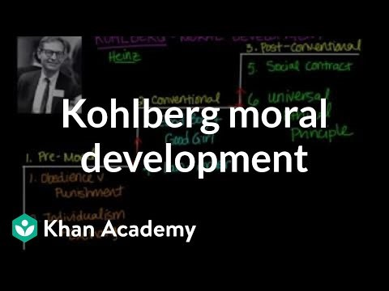
Kohlberg moral development | Individuals and Society | MCAT | Khan Academy
Notes:
https://www.youtube.com/watch?v=Onkd8tChC2A

Slide 78
khoberg
This cognitive theory was based on Piaget’s work (1966), who was a child psychologist.
The theory describes the stages of moral development through which individuals pass as they mature in their moral judgment.
Kohlberg argues that moral reasoning abilities develop according to a stage sequence. – and there are 6 stages.
Each stage is characterized by the reasons a person gives for making what they consider the right or moral decision, when faced with an ethical dilemma.
So this theory is concerned with the rationale that people use in making moral decisions.
After doing his study of a group boys over a period of time,
Kohlberg concluded that there are three distinct levels of moral reasoning,
namely pre-conventional, conventional and post-conventional,

Slide 79
Kohlberg’s stages of cognitive moral development
Stage 1 punishment and obedience orientation
Stage 2 instrumental purpose and exchange orientation
Stage 3 Interpersonal Accord - Conformity – Mutual Expectations (Good boy/girl orientation)
Stage 4 System Maintenance - Upholding duties, laws
Stage 5 social contract and rights
Stage 6 Universal ethical principle
Notes:
This cognitive theory was based on Piaget’s work (1966), who was a child psychologist.
The theory describes the stages of moral development through which individuals pass as they mature in their moral judgment.
Kohlberg argues that moral reasoning abilities develop according to a stage sequence. – and there are 6 stages.
Each stage is characterized by the reasons a person gives for making what they consider the right or moral decision, when faced with an ethical dilemma.
So this theory is concerned with the rationale that people use in making moral decisions.
After doing his study of a group boys over a period of time,
Kohlberg concluded that there are three distinct levels of moral reasoning,
namely pre-conventional, conventional and post-conventional,
each containing two stages.
The stages are :

Slide 80
Pre-conventional level
Stage 1 punishment and obedience orientation
Stage 2 instrumental relativism orientation
Notes:
At the pre-conventional level there are 2 stages:
At this level a person is primarily concerned with what effect a chosen action will have on them /not the effect on others.
At this level, a person does what is right in order to avoid punishment or to get a reward. People at this level are exclusively self-centred.
One does the right thing to get rewarded or to avoid punishment
For eg you achieve a sales target and you get a bonus/holiday etc) home/work use
So in stage 1, the likelihood and avoidance of punishment determines whether an action is right or wrong – obedience to fixed rules and to act ethically in order to avoid punishment . (but persons at this stage would Do the wrong thing if they can get away with it!!)
At stage 2 individuals define right as that which serves his or hers own needs. At this stage the individual no longer makes moral decisions solely on the basis of specific rules or authority figures. The action is considered ethical if the benefits to the decision maker exceeds the cost. People do consider others as far the notion “You Scratch my back and I ll scratch yours”
Foe example, accepting gifts while overseas Stage 1 yes – can’t get caught. No - against rule of the company and will get into trouble
Stage 2 yes I deserve the expensive present, and it doesn’t matter if it is against coy rules.
Everyone starts at this level of reasoning when they are young.
An accountant in Stage 1 will disclose all the company’s taxable income to avoid fines by the ATO. But would do the wrong thing if the likelihood of getting caught is low.
At Stage 2 may not declare all of the taxable income to obtain a financial benefit from the tax savings, and submit a tax return specifying a lower than appropriate taxable income for a client who in turn promises to give the tax agent a reward for any saving in tax liability.

Slide 81
Pre-conventional level
At the pre-conventional level there are 2 stages:
At this level a person is primarily concerned with what effect a chosen action will have on them /not the effect on others.
At this level, a person does what is right in order to avoid punishment or to get a reward. People at this level are exclusively self-centred.
One does the right thing to get rewarded or to avoid punishment
For eg you achieve a sales target and you get a bonus/holiday etc) home/work use

Slide 82
Stage 2
So in stage 1, the likelihood and avoidance of punishment determines whether an action is right or wrong – obedience to fixed rules and to act ethically in order to avoid punishment . (but persons at this stage would Do the wrong thing if they can get away with it!!)
At stage 2 individuals define right as that which serves his or hers own needs. At this stage the individual no longer makes moral decisions solely on the basis of specific rules or authority figures. The action is considered ethical if the benefits to the decision maker exceeds the cost. People do consider others as far the notion “You Scratch my back and I ll scratch yours”
Foe example, accepting gifts while overseas Stage 1 yes – can’t get caught. No - against rule of the company and will get into trouble

Slide 83
Stage 2
Stage 2 yes I deserve the expensive present, and it doesn’t matter if it is against coy rules.
Everyone starts at this level of reasoning when they are young.
An accountant in Stage 1 will disclose all the company’s taxable income to avoid fines by the ATO. But would do the wrong thing if the likelihood of getting caught is low.
At Stage 2 may not declare all of the taxable income to obtain a financial benefit from the tax savings, and submit a tax return specifying a lower than appropriate taxable income for a client who in turn promises to give the tax agent a reward for any saving in tax liability.

Slide 84
Stage 3
Movement from the pre-conventional to the conventional level reflects a growing awareness of the SELF in relation to others, which takes on an increasing significance in moral development.
At this level, it is not what the person thinks is important, but what the group of society, (family, friends, work) thinks is correct.

Slide 85
Stage 3
The individual has an image to maintain and this awareness provides guidance on what to do. For a person at Stage 3, actions are dominated by stereotypical behaviour associated with one’s position or role (work/society role).
For example, a Financial Counsellor at this stage WILL ACT according to the way an Financial Counsellor is supposed to act, with competence, due care and professionalism. Furthermore, Stage 3 people often make moral judgments that are considered to be good within the context of interpersonal relationships and expectations. In other words they will act to please, and to look good in the eyes of their significant others, normally family, peers and superiors.

Slide 86
Stage 4
For a Stage 4 person, the law is considered greater than the individual, and adherence to codes and laws that are imposed externally determines ‘right’ behaviour –so loyal to the larger society is also very important.
Stage 4 Financial Counsellors will be guided by the code of conduct, company policies and regulations such as the acting standards.
A Stage 3 person – will follow an unethical boss’s instructions-wrong perception of their fiduciary duties and may regard ‘doing what he/she is expected to do in line with his/her peers’ as being right. CFO at Harris Scarfe, manipulated a/cs satisfy management’s request,

Slide 87
Stage 4
At the conventional level a person is more concerned with the relationship one has with the people close to them or to society in general, and how this relationship will be affected by chosen actions.
At the conventional level a person generally follows society’s laws and expectations rigidly because they are mutually beneficial.
Thus, morality is basically following the rules and laws of society, and they serve as the parameters of appropriate conduct.

Slide 88
Conventional level
Stage 3 Good boy/girl orientation
Stage 4 law and order
Notes:
Movement from the pre-conventional to the conventional level reflects a growing awareness of the SELF in relation to others, which takes on an increasing significance in moral development.
At this level, it is not what the person thinks is important, but what the group of society, (family, friends, work) thinks is correct.
The individual has an image to maintain and this awareness provides guidance on what to do. For a person at Stage 3, actions are dominated by stereotypical behaviour associated with one’s position or role (work/society role).
For example, an accountant at this stage WILL ACT according to the way an accountant is supposed to act, with competence, due care and professionalism. Furthermore, Stage 3 people often make moral judgments that are considered to be good within the context of interpersonal relationships and expectations. In other words they will act to please, and to look good in the eyes of their significant others, normally family, peers and superiors.
For a Stage 4 person, the law is considered greater than the individual, and adherence to codes and laws that are imposed externally determines ‘right’ behaviour –so loyal to the larger society is also very important.
Stage 4 accountants will be guided by the code of conduct, coy policies and regulations such as the a/cting standards.
A Stage 3 person – will follow an unethical boss’s instructions-wrong perception of their fiduciary duties and may regard ‘doing what he/she is expected to do in line with his/her peers’ as being right. CFO at Harris Scarfe, manipulated a/cs satisfy management’s request,
At the conventional level a person is more concerned with the relationship one has with the people close to them or to society in general, and how this relationship will be affected by chosen actions.
At the conventional level a person generally follows society’s laws and expectations rigidly because they are mutually beneficial.
Thus, morality is basically following the rules and laws of society, and they serve as the parameters of appropriate conduct.

Slide 89
Lets define what is a social contract the view that a person's moral or political obligation are dependent upon a contract or agreement between them and society.
At stage 5 a person defines what is ‘right’ through general individual rights and standards AND the law agreed on by society.
Individuals feel a sense of commitment or obligation to a social contract. But disobedience to rules or the law are justified in the case that fail to respect individuals – such as loss of life or liberty.
A person reaching stage six would be defining ‘right’ using their inner conscience and self chosen ethical principles, advocating justice and equality universally, as found in deontological ethics - Principle ethics.
A person at the post-conventional level
defines their personal values in terms of their chosen principles and
differentiates themselves from the rules and expectations of others.
may evaluate, question and may even seek to change the laws, if they are not based on justice and welfare.

Slide 90
Post conventional level
Stage 5 social contract
Stage 6 Universal ethical principle
Notes:
Lets define what is a social contract the view that a person's moral or political obligation are dependent upon a contract or agreement between them and society.
At stage 5 a person defines what is ‘right’ through general individual rights and standards AND the law agreed on by society.
Individuals feel a sense of commitment or obligation to a social contract. But disobedience to rules or the law are justified in the case that fail to respect individuals – such as loss of life or liberty.
A person reaching stage six would be defining ‘right’ using their inner conscience and self chosen ethical principles, advocating justice and equality universally, as found in deontological ethics - Principle ethics.
A person at the post-conventional level
defines their personal values in terms of their chosen principles and
differentiates themselves from the rules and expectations of others.
may evaluate, question and may even seek to change the laws, if they are not based on justice and welfare.

Slide 91
Moving through the stages
Age
Sex
Education / Studying ethics
Work experience
Culture/family
Notes:
AGE – as you get older you learn and understand more – your values and ethical values may will probably change.
Past research has revealed that Post conventional development rarely occurs before the mid 20’s age, if it occurs at all.
Most people (80%) do not go beyond the conventional level of reasoning (stage 3 and 4)
SEX – your sex or gender influences they way you think more than you can imagine.
According (Gilligan)to the gender socialisation theory, gender identity, the core of personality, becomes established as early as age three through the mother-child relationship and is thereafter irreversible and unchanging. It is believed that gender differences of infancy are reinforced through the pattern of childhood games,
The ‘traditional boys games’ teach respect for rules and fairness, while the ‘traditional girls games’ teach respect for inclusion and avoiding hurt.
Therefore, it can be said that males and females as adult employees will bring different ethical values to the workplace, differentially shaping their work-related decisions.
Education Accounting –– accountants and students achieve low DIT scores in comparison with other students and professionals from other disciplines - rule based individuals.
Studying ETHICS –proven to improve employees moral development –knowing about ethical issues, different ethical theories, code of conduct, people having choices to dilemmas
WORK experience – working in an ethical corporate culture with ethical people also influence the moral reasoning development of individuals
Other influences that affect character traits and moral development are family, upbringing and personal experience

Slide 92
Why is Cognitive Moral Development Important?
Because:
Many people reason at the lower levels
Most people reason at the conventional level and are looking outside themselves for guidance
That makes “leading” on ethics essential

Slide 93
Focusing on Self
What is in our control?
When our values are not met by others how do we manage our- selves?
How do we honour our own values towards our self?
How do we live our values towards other people?
How do our values fit with the values of the organisations we work for?
How does that sit within the values and ethics of the Financial Counselling profession?

Slide 94
Locus of control
An individual with a high internal locus of control believes that outcomes are primarily the result of his or her own efforts, - you make things happen and take responsibility for your actions

Slide 95
Locus of control
Whereas an external would believe that life events are determined primarily by fate, luck or powerful others. Do you just obey without question and blame others or the environment for your actions or do you stick to your principles and of course take responsibility for your actions or inactions – Controlling boss requesting you to do something which you perceive to be inappropriate??

Slide 96
Locus of Control
An individual’s perception of how much control he or she exerts over events in life.
External
Internal
Notes:
Locus of control – refers to an individuals perception of how much control he or she exerts over life events.
You are an either considered as more of an internal or an external. Locus of control is similar to a personality trait that characterises a person’s thinking and action across situations.
An individual with a high internal locus of control believes that outcomes are primarily the result of his or her own efforts, - you make things happen and take responsibility for your actions, Whereas an external would believe that life events are determined primarily by fate, luck or powerful others. Do you just obey without question and blame others or the environment for your actions or do you stick to your principles and of course take responsibility for your actions or inactions – Controlling boss requesting you to do something which you perceive to be inappropriate??
Although locus of control does not shift easily some events can cause people to change the way they think... Prisoner of war with little chance of escape.. May develop a more external locus of control over time

Slide 97
Connection to Ethical Behaivor?
Internals are more likely to see the connection between their own behavior and outcomes and therefore take responsibility for their behavior.
Therefore, internals are more likely to do what they think is right

Slide 98
Machiavelli
Nicollo Machiavelli, A 16th century philosopher and political theorist who is associated with promoting a pragmatic leadership style that include unethical behaviour to achieve self interested outcomes.
He said “Do good if he can but...commit evil if he must”...
So, Individuals who act in self interest, always are opportunistic, deceptive and manipulative to
win no matter what the cost or
how it affects other people are described to be Machiavellian.
People who think that the end justify the means even if you act unethical to achieve the end is considered to be a Machia-vellianism trait.
So people that have these traits are more likely to have unethical intentions and engage in actions such as lying, cheating and accepting kickbacks

Slide 99
Machiavellianism
Self interested
Opportunistic
Deceptive
Manipulative
Notes:
Nicollo Machiavelli, A 16th century philosopher and political theorist who is associated with promoting a pragmatic leadership style that include unethical behaviour to achieve self interested outcomes.
He said “Do good if he can but...commit evil if he must”...
So, Individuals who act in self interest, always are opportunistic, deceptive and manipulative to
win no matter what the cost or
how it affects other people are described to be Machiavellian.
People who think that the end justify the means even if you act unethical to achieve the end is considered to be a Machia-vellianism trait.
So people that have these traits are more likely to have unethical intentions and engage in actions such as lying, cheating and accepting kickbacks

Slide 100
Euphemistic language
These mechanisms allows us to behave unethically without feeling bad about ourselves. We justify it to ourselves in a way to feel good about our unethical behaviour
Euphemistic language – we name or label actions in a way that minimises the ethical overtones of this action eg troubled assets instead of toxic assets. Monitor employees use of internet - spying on employees. Make the action seem more right and less unethical

Slide 101
Moral Disengagement
The tendency for some individuals to deactivate their internal control system in order to feel okay about doing unethical things
Eight mechanisms used for doing this
  Euphemistic language
  Moral justification
  Displacement of responsibility
  Advantageous comparison
  Diffusion of responsibility
  Distorting consequences
  Dehumanization
  Attribution of blame
Notes:
These mechanisms allows us to behave unethically without feeling bad about ourselves. We justify it to ourselves in a way to feel good about our unethical behaviour
Euphemistic language – we name or label actions in a way that minimises the ethical overtones of this action eg troubled assets instead of toxic assets. Monitor employees use of internet - spying on employees. Make the action seem more right and less unethical

Slide 102
Moral Disengagement
STOP
AND
THINK
“It’s not my responsibility - my boss told me to do it.”
“It’s not my responsibility – my team decided this.”
“It’s no big deal!”
“It’s not as bad as (what someone else) is doing.”
“They deserve whatever they get.”
“They brought this on themselves.”

Slide 103
Cognitive Barriers to Good Ethical Judgment
Barriers to Fact Gathering
  Overconfidence
  “Confirmation Trap”
Barriers to Consideration of Consequences
  Reduced number
  Self vs. others
  Ignore consequences that affect few
  Risk underestimated: illusion of optimism, illusion of control
  Consequences over time

Slide 104
Toward Ethical Action
Script Processing
  Cognitive frameworks that guide our thoughts and actions
Cost-Benefit Analysis
  Too simplistic a way of analyzing
  No moral dimension

Slide 105
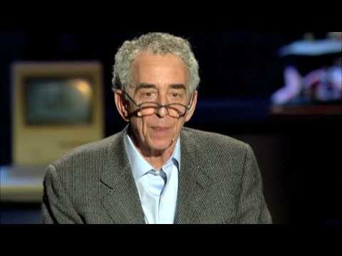
Barry Schwartz: Our loss of wisdom
Notes:
https://www.youtube.com/watch?v=lA-zdh_bQBo

Slide 106
Reference List
1. Whetstone, J. T. (2001). How virtue fits within business ethics. Journal of Business Ethics, 33(2), 101-114.
http://link.springer.com/content/pdf/10.1023/A:1017554318867.pdf
2. Treadway Report
http://www.coso.org/Publications/NCFFR.pdf

