Slide 1
Self Care, Well-Being & Avoiding Burnout
FCA Conference, Hobart 2019
Noeline Davis - Anglicare

Slide 2
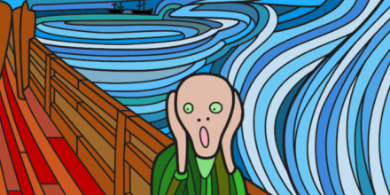
Why worry about well-being and self-care?
Because there is an emotional price to the work that we do, an emotional price to caring

Slide 3
The Impact of working in a high intensity profession can result in:
Compassion Fatigue
A state of tension and preoccupation with individual or cumulative trauma of clients
Burnout
Physical or emotional exhaustion, especially as a result of long-term stress.
Vicarious Trauma
The transformation or change in a helper’s inner experience as a result of responsibility for an empathic engagement with traumatised clients.

Slide 4

There is Hope
Vicarious Trauma, Compassion Fatigue and Burnout can be resolved successfully with self-care practices and professional support. Centre for Excellence in Therapeutic Care
What to look out for ……

Slide 5
Professional Quality of Life
Compassion Satisfaction
Compassion Fatigue

Slide 6
Compassion Satisfaction
Compassion satisfaction is the pleasure you derive from doing your work
You may feel it is a pleasure to help others through your work
You may feel positively about your colleagues and your ability to contribute to your organisation

Slide 7
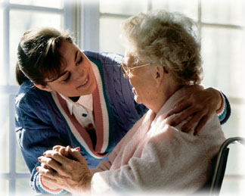
Compassion Satisfaction
.

Slide 8

What is Compassion Fatigue?

Slide 9
Compassion Fatigue
Compassion Fatigue refers to the emotional and physical erosion that takes place when helpers are unable to refuel and regenerate
Compassion Fatigue (Figley 1995). Anyone who suffers as a result of serving in a helping capacity

Slide 10
Burnout
Burnout is a state of chronic stress that leads to: physical and emotional exhaustion and feelings of ineffectiveness and lack of accomplishment
Burnout often involves low job satisfaction, feeling powerless and overwhelmed at work.
Burnout does not mean that a person’s view of the world has been damaged or that they have lost the ability to feel compassion for others.
Burnout may occur in a job because of:
  the types of client situations a worker deals with
  the volume of work
  because of a toxic leader or
  all of the above.

Slide 11

Vicarious Trauma
“As we listen empathically to the stories of our clients, it becomes impossible not to enter their world and experience their pain.”
(Shallcross, 2013)

Slide 12
Vicarious Trauma
By working with traumatised individuals you can experience vicarious trauma as a result of empathically listening or resonating with the stories you are told about their experiences
How we engage empathically is important
Vicarious trauma is when your sense of yourself, your sense of relationships with other people and your sense of the world is negatively transformed
Some workers may experience similar physiological effects or symptoms as the traumatised person. Such as:
poor sleep and nightmares intrusive thoughts signs of anxiety such as being alert for danger | easily startled heart racing a fear of things going wrong, and feeling generally more unsafe

Slide 13
Summary of Risk Factors for Compassion Fatigue, Burnout and Vicarious Trauma
Experiences of your own personal trauma
Unrealistic expectations of yourself
Inability or unwillingness to attend to self-care (our self-talk)
Inability to recognize that you are being affected by the work – unable to take some preventative self-care action
Demands are too high from: others, a situation, the workplace
Lack of resources and time - and lack of control over work
Workplace is not trauma informed
Lack of support and acknowledgement from higher management or organisational supports

Slide 14
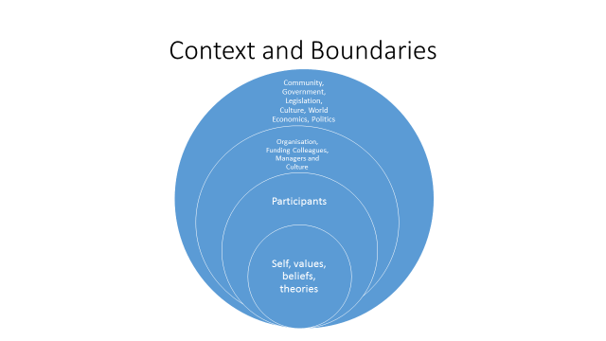
Notes:
Notes
We work within a context and boundaries as per the diagram above. Refer back to this for role and boundary clarity.

Slide 15
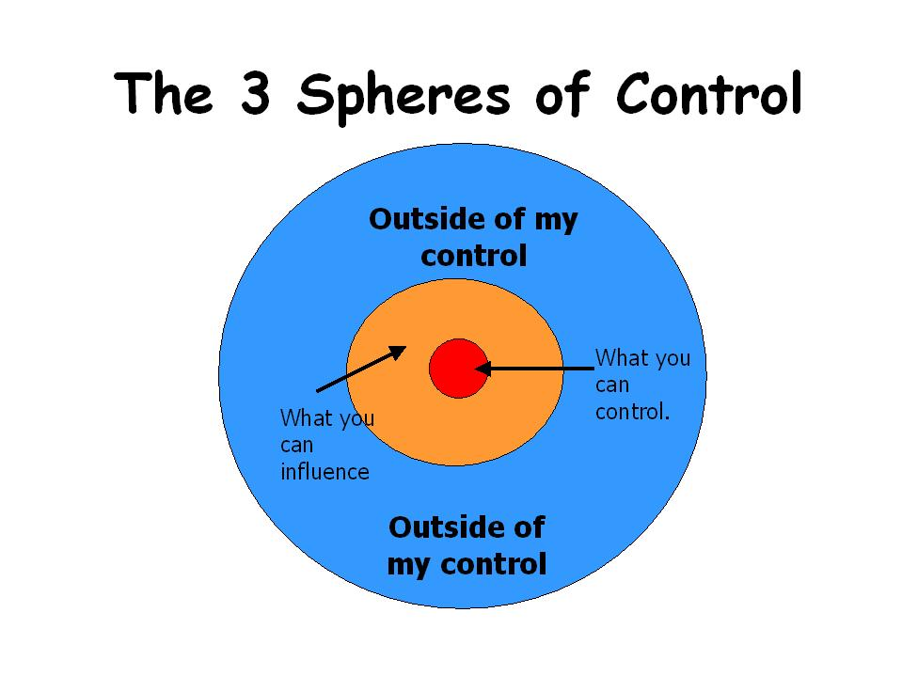
What is in our control?
Notes:
Notes
As in previous practice discussion it is important to remind ourselves of what is in our control, what we have influence over and what it out of our control.

Slide 16

What is in our control in the work environment?

Slide 17
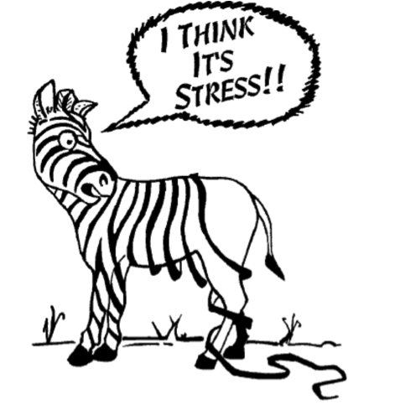
When to seek support
We can often be the last to notice the impacts of caring
When colleagues, family and friends express concern
When you stop doing the things you enjoy or that support you

Slide 18
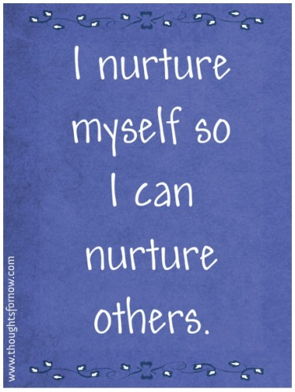
Where does Self-Care Fit in?
Self-Care is important to mitigate or reduce the risk of Compassion Fatigue, Burnout and Vicarious Trauma
Flying analogy – oxygen mask on self before others

Slide 19
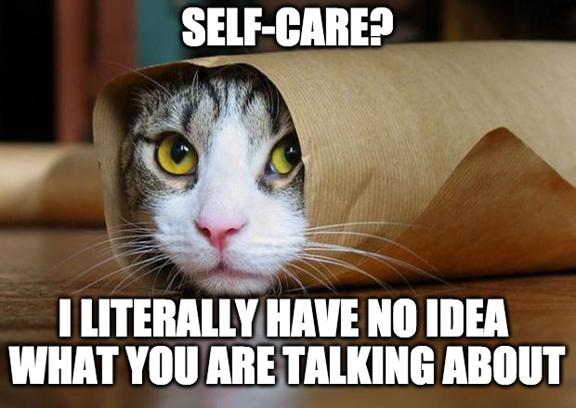

Slide 20
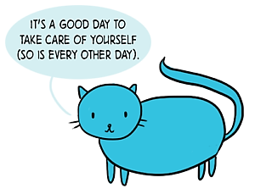
ABCs of Self Care
Awareness
Personal
Balance
Connection
Professional

Slide 21
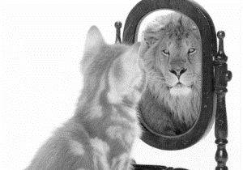
AWARENESS
Recognise and identify symptoms
Monitor changes in symptoms over time
Recognise and monitor changes in functioning
Engage in Supervision and consultation
Seek help with your own traumas
Know your triggers

Slide 22
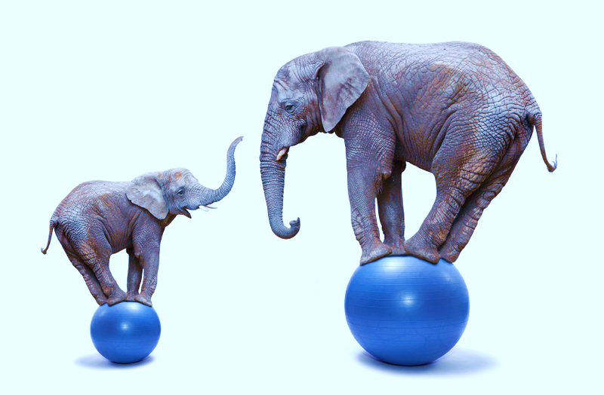
BALANCE
Make your personal life a priority
Protect your time
Attend to your physical and mental health
Have healthy escapes
Balance caseload, time and tasks
Take time out for relaxation and reflection
Set and maintain appropriate professional boundaries
Seek and engage in professional supervision and briefing
Monitor the continuum of No care to Over-care

Slide 23

CONNECTION
Make relationships with family and friends a priority
Revitalise your sense of life’s purpose and meaning
Develop and utilise a professional support network
Remember why you do what you do
Refocus on the rewards of your work
Ensure you are not your only reference point

Slide 24
Self - Care
  Address the whole person:
  physically
  psychologically
  emotionally
  spiritually
  personally
  professionally, and
  include stress reducing activities in which you will regularly and habitually engage

Slide 25
Self- Care
Develop a personalised self-care plan that fits into your:
    lifestyle
    personality
    Resources, and
    interests

Slide 26
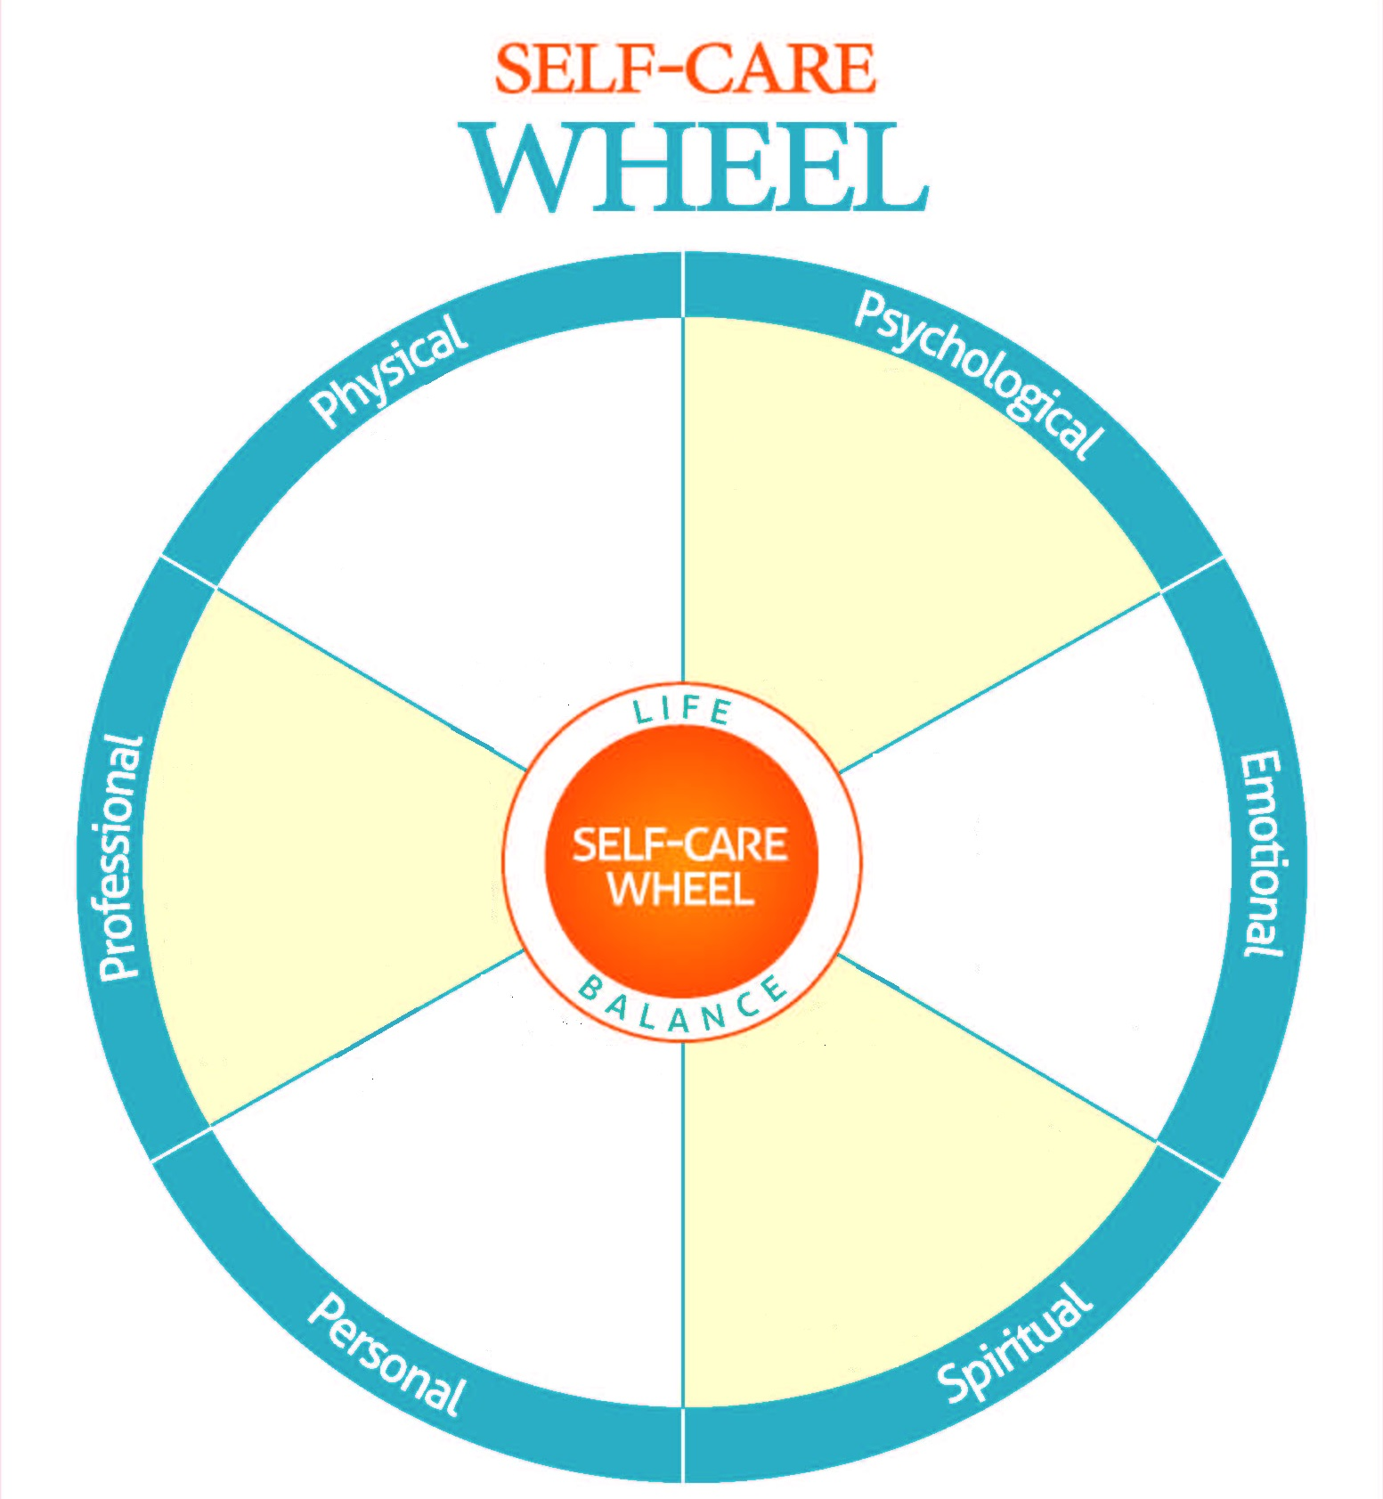
The Self-Care Wheel
This wheel breaks self-care down into six equal parts of life: Physical, Psychological, Emotional, Spiritual, Personal, and Professional.
Take a look at the wheel and the suggestions in each of the areas.
Which of these are you strong in?
Which facet could use more of your attention?
Fill in the wheel with your own activities and tools for self-care.
https://practicingplay.wordpress.com/category/self-care/

Slide 27
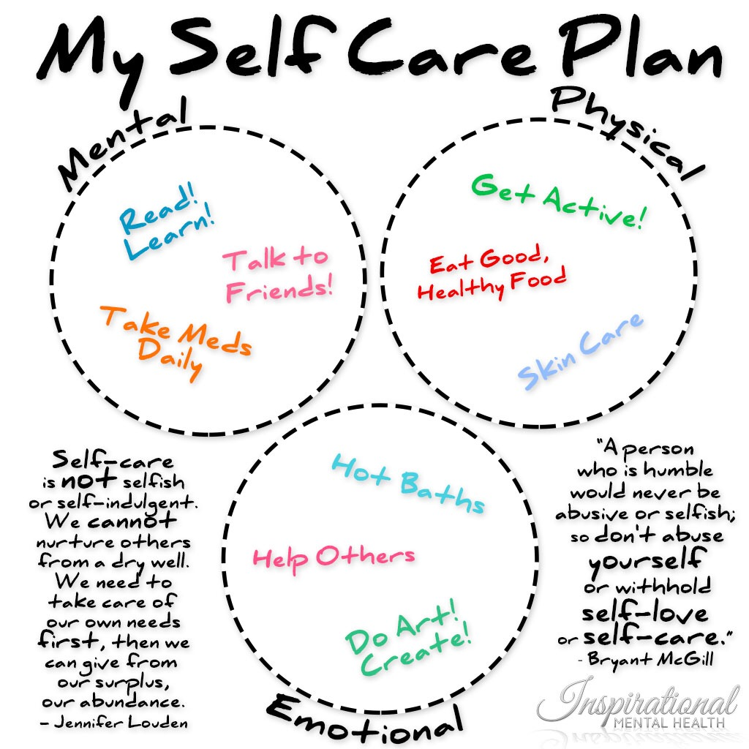
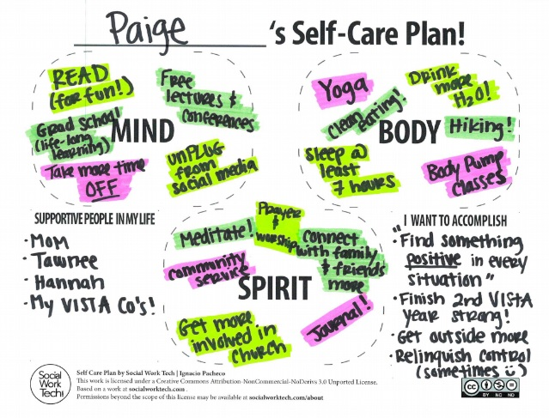
Examples of Self-Care Plans

Slide 28
What to do about burnout
The importance of Annual Leave
Use the “Three R’ Approach
  Recognize: Watch for the warning signs of burnout
  Reverse: Undo the damage by managing stress and seeking support (EAP, it is free!)
  Resilience: Build your resilience to stress by taking care of your physical and emotional health

Slide 29
Coping Strategies
Escape: Getting away from it all, physically or mentally (books or films, taking a day or a week off, playing video games, talking to friends about things other than work);
Rest: Having no goal or time-line, or doing things you find relaxing (lying on the grass watching the clouds, sipping a cup of tea, taking a nap, getting a massage); and
Play: Engaging in activities that make you laugh or lighten your spirits (sharing funny stories with a friend, playing with a child, going for a bike ride, being creative, being physically active).

Slide 30
Coping Strategies
Remind yourself of the importance and value of humanitarian work
Stay connected with family, friends, and colleagues
Notice and deliberately pay attention to the “little things” that really aren’t so little – small moments of quiet, the sound of the wind in the trees, or brief connections with others

Slide 31
Coping Strategies
Mark transitions, celebrate joys, and mourn losses with people you care about through traditions, rituals, or ceremonies
Take time to reflect (e.g., by reading, writing, prayer, time in nature and meditation)
Identify and challenge your own cynical beliefs, and
Undertake growth-promoting activities (learning, writing in a journal, being creative).

Slide 32
Managing Vicarious Trauma when supporting others
Working with people who are experiencing adversity, crises or who are struggling with substance abuse or mental illness is a high-intensity profession
We may empathise with our clients - therefore, feelings of helplessness, anger, and fear are common
Workers who are parents or who have histories of childhood trauma, might be at particular risk for experiencing these reactions
The workplace has a responsibility for the safety and well-being of workers. Ensuring quality practice-supervision and appropriate workloads is essential to a trauma informed work place

Slide 33
Empathy
“…After all, it’s our gift for empathy that draws us to our work. And yet, empathy at full throttle–felt and projected 100 percent with our bodies, hearts, and minds–has its risks. Without some sense of separation, our capacity to help clients erodes. Keeping something in reserve doesn’t make us heartless or cold. Far from it: the most heartfelt and healing work we do is when we’re in complete possession of ourselves, and can bring to our clients a full measure of thoughtful, problem-solving compassion.”
(Understanding the Dangers of Empathy, Babette Rothschild)
Two articles by Babette Rothschild that may be useful reading:
Mirror Mirror: Our brains are hardwired for empathy
Understanding the Dangers of Empathy

Slide 34
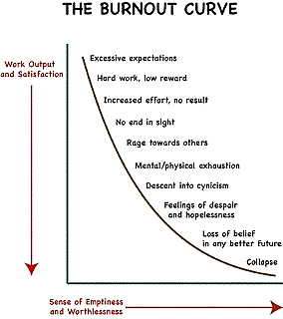
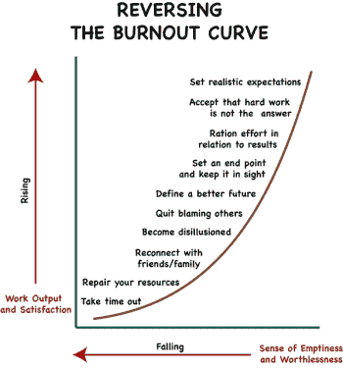

Slide 35

The work you do is hard.
Remember to take care of yourself.

Slide 36

Thank You

Slide 37
Burnout is defined as, “A breakdown of the psychological defences that a worker uses to cope with intense job related stress.” It is a syndrome in which workers feel emotionally exhausted or fatigued, withdraw emotionally from their clients, and perceive a diminution of their achievement or accomplishments.
A prolonged response to chronic emotional and interpersonal stressors on the job, determined by the dimensions of exhaustion, cynicism, and inefficacy. (Maslach, Schaufeli, & Leiter, 2001)

