Slide 1

FCA Update
Fiona Guthrie and Phil Powell
Financial Counselling Tasmania
October 2015
Notes:
Outline of FCT Presentation
(Run through on the Sunday night)
We have 30 minutes
Bring copy of Duds and Mugs
We are introduced, Phil to start
Phil -
say that Carmel sends her apologies

Slide 2
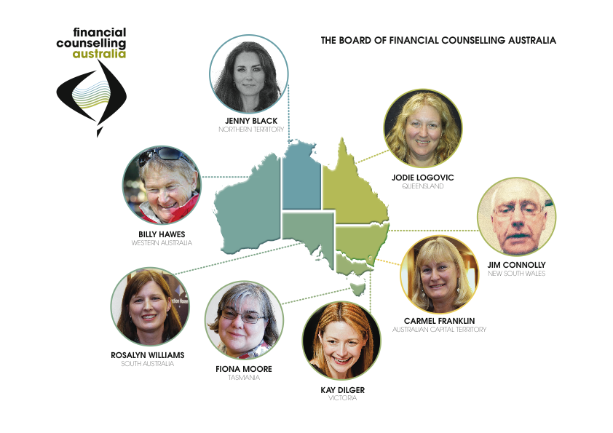
Notes:
Picture to be updated –
Phil
Structure is a federation
explain the role of State representatives, oversee the national body, make decisions in the best interests of FCA

Slide 3

Helping you to do your jobs
Notes:
Fiona – one of FCA’s major roles is to help you do the best possible job you can
Phil and I are going to run through some of the changes you’ll see …

Slide 4

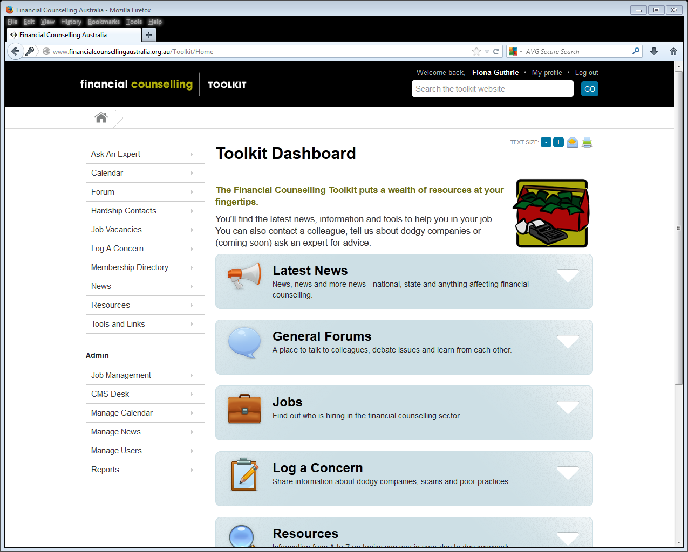
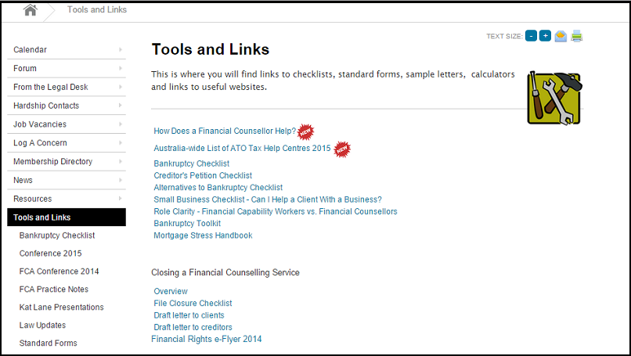
We’re re-structuring the toolkit website and adding new resources
Notes:
FIONA
The first one is ….
Restructuring of toolkit website + ability to track your own CPD

Slide 5
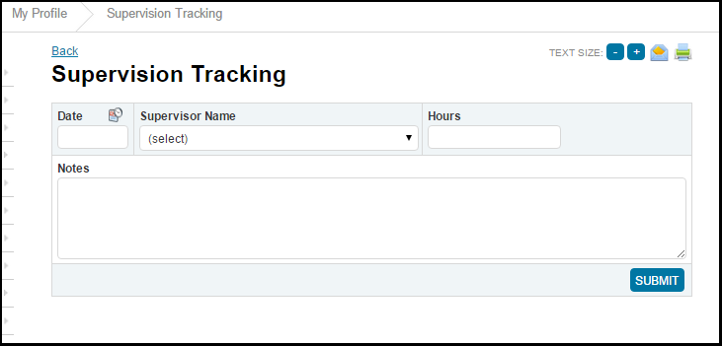
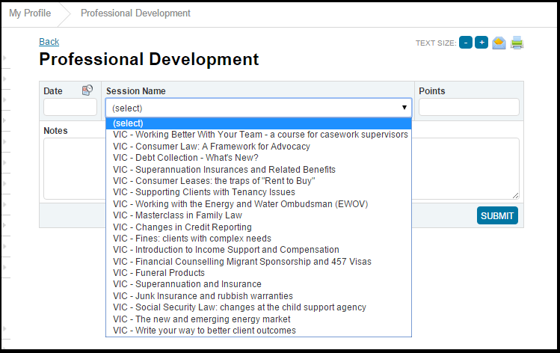
Supervision and PD Tracking
Notes:
FIONA

Slide 6


We will employ a person to coordinate training through the sector
Notes:
Phil
Training coordination – for the whole sector – ad is out for the position now

Slide 7

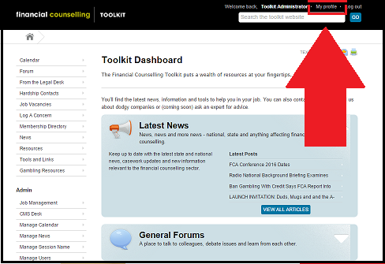
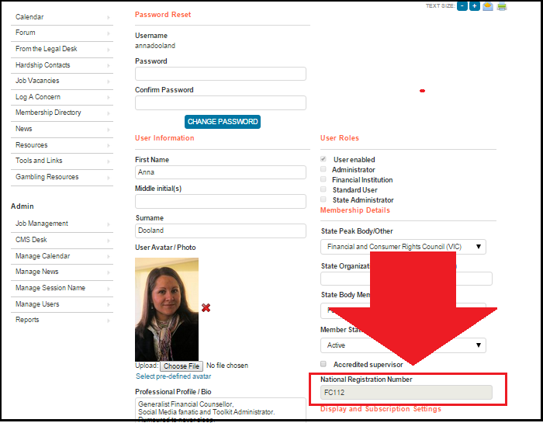
This is where you’ll find your NRN
Notes:
Fiona to explain how to find your NRN
Very simple – click on “My Profile” at the top of the page
When you go to “My Profile” you’ll see your NRN below

Slide 8
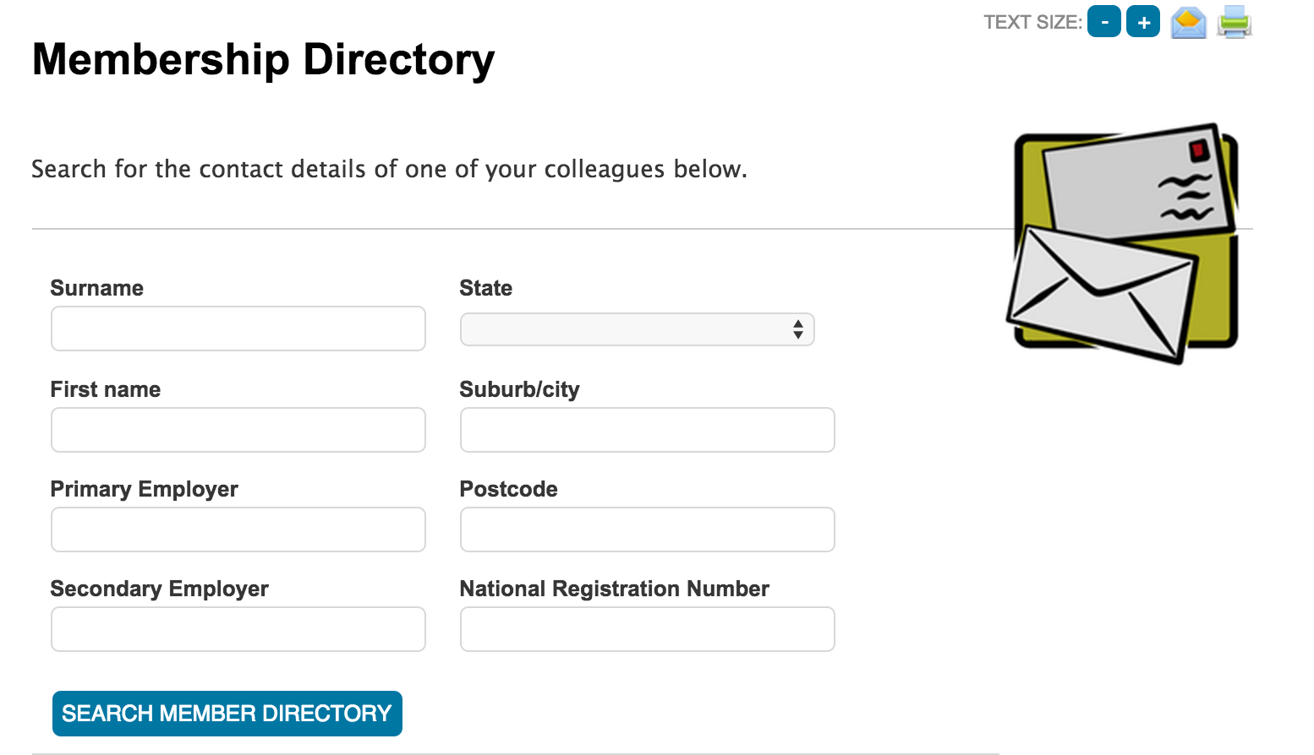






Creditors will be able to verify your contact information & NRN
Notes:
PHIL
National Registration Numbers
The picture shows what will be visible when creditors search for a financial counsellor

Slide 9

A Community of Practice for Financial Capability Workers
Notes:
Fiona
Setting up a community of practice
Providing support and resources to this group

Slide 10

There will be a new website targeting people in financial difficulty who can “self help” or can be encouraged to contact a financial counsellor..
Notes:
Phil
New website for the 1800 007 007 service
More professional, much better targeted
Phil – below is from a document that we put together about the website
The organisation goal that the website supports
Help people in financial difficulty make an informed decision about their financial issues and take the next step to get back on track.
The NDH brand wants to be
The authority on the topic of the best ways to address personal financial difficulty – own the space.
Success to the website user looks like
“I know what I have to do next and feel confident to do it.”
Website (and Brand) Attributes
Independent, trustworthy, comprehensive, easy to understand and act on

Slide 11
The Big Picture
Notes:
Fiona
And what is the strategic direction for FCA?

Slide 12
What we’re doing about funding…
Notes:
FIONA
The number 1 priority that the FCA board gave to us was FUNDING – fix it!
There are four overlapping options that we want to explore: charitable trust, voluntary contributions from industry, the Federal/State partnership and the industyr levy.
To get these debated and put on the table – we want to convince the Govt to hold an inquiry into the funding for financial counselling

Slide 13

Notes:
PHIL
problem gambling re-funding, seen the report, thanks for input, made a huge difference, working on campaign to get problem gambling funding continued

Slide 14

Notes:
FIONA

Slide 15

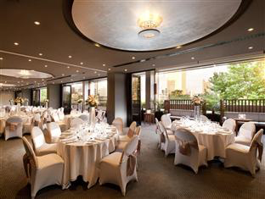


Register early for 2016
to win a weekend for 2 at the Hilton Hotel, Adelaide
Enjoy a getaway at Hilton Adelaide for two guests including;
2 nights in Hilton King Deluxe Room and full buffet breakfast to the value of $1108
Notes:
FIONA

Slide 16
Notes:
Fiona
Interview Phil for a few minutes
What have you seen change over the past 15 years??

