Slide 1
An introduction to FOS and our approach to financial elder abuse
Philip Field, Lead Ombudsman – Banking & Finance
October 2017
Notes:
Good morning everyone, and thank you for coming along to the session.
My name is Philip Field and I’m the Lead Ombudsman - Banking & Finance, from the Financial Ombudsman Service
I would like to begin by acknowledging the Punnilerpanner people (pronounced: poo-nill-err-panner) as the traditional owners and custodians of the land on which we meet today. I pay my respects to Elders past, present and future, and Elders from other communities who may be here today.

Slide 2
What we will cover
A brief overview of FOS
Elder abuse – definitions and considerations
Financial elder abuse
Warning signs
What is expected of financial services providers
The FOS Approach – examples
Q&A
Notes:
Feel free to interrupt me at any time, and there will be time at the end for questions – I look forward to hearing about any experiences particularly relating to financial elder abuse that you might like to share.

Slide 3
About the Financial Ombudsman Service Australia - FOS
Fair and independent dispute resolution that is free to consumers (individual and small business)
We proceed with the minimum formality and technicality
We apply principles of procedural fairness
Decisions accepted by applicants are binding on the financial services provider
We identify systemic issues, which have an effect on people beyond parties to an individual dispute
We investigate alleged breaches of Codes of Practice
Notes:
As an alternative dispute resolution scheme, FOS investigates disputes with the minimum amount of formality.
We observe the principals of procedural fairness and rely on documentary information to form any final view.
Having said that, our aim is to facilitate the resolution of a dispute in the most appropriate manner depending on the parties and issues involved in the most efficient manner possible.
We do what is fair in all the circumstances having regard to the law, good industry practice and approaches followed in previous decisions.
Our approaches are available on our website
Systemic Issues investigation
In additional to our role of resolving individual disputes, FOS is required by ASIC to identify, resolve and report on systemic issues (and to notify ASIC of cases of serious misconduct).
Systemic issues have an effect on people beyond the parties to the dispute eg. incorrect fees charged to an applicant were found to have been charged to many others due to system error.
Code compliance monitoring
FOS Code supports independent committees to monitor compliance with codes of practice in the Australian financial services industry to achieve service standards people can trust.
They aim to help financial services providers:
Build good relationship with their customers
Improve complaints handling
Reduce the number of customer disputes through improved service delivery.
FOS Code services are funded by the industry associations responsible for these codes, in accordance with service level agreements.

Slide 4
2016/17 snapshot
Total disputes received
39,479
16%
Total disputes closed
39,481
20%
Financial difficulty disputes accepted
2,742
5%
Notes:
As you can see from this graph, the majority of disputes we see relate to Credit, followed by General Insurance matters.
Consumer representative are most likely to come to FOS to seek a review of a financial service provider’s failure to consider a financial hardship arrangement for their clients, we also see a number of dispute lodged by consumer representatives about:
Responsible lending
Transaction issues such as direct debit arrangements
Inappropriate fees and charges
Credit default listings

Slide 5
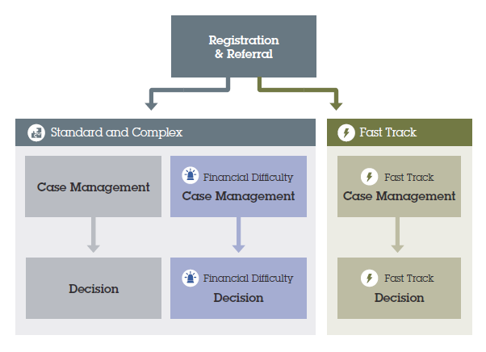
What happens to a dispute you lodge with FOS?
Notes:
Melanie Hallam, our Community Outreach Officer here today has brought along a fact sheet which includes a detailed process map and more information about our Terms of Reference, compensation caps and the types of remedies we might award. I recommend you visit the FOS stand to pick one up, if you haven’t already. Melanie has also brought along a copy of the presentation on usb for you. Our revised Approach to financial elder abuse will be published in the FOS circular on the 27th of this month.

Slide 6
Financial elder abuse
Notes:
Okay, after that brief look out how we work, let’s move on to the reason we’re here today, and that’s to discuss financial elder abuse.
I think it’s fair to say that the importance of addressing this issue becomes more and more pressing as we age as a society.

Slide 7
What is elder abuse – definitions and considerations
A single, or repeated act, or lack of appropriate action, occurring within any relationship where there is an expectation of trust which causes harm or distress to an older person.
Any act occurring within a relationship where there is an implication of trust, which results in harm to an older person.
World Health Organisation
Australian Institute of Family Studies
Notes:
FOS first released our approach to financial elder abuse in 2007. With our aging population, more people are becoming aware of the need to so more to protect our elderly, especially when they are doing their banking. This was highlighted further when in 2014 the Australian Bankers Association released an industry guideline called protecting vulnerable customers from potential financial abuse.
As our population ages, the problem can only become more widespread.

Slide 8
What is elder abuse – definitions and considerations
A single, or repeated act, or lack of appropriate action, occurring within any relationship where there is an expectation of trust which causes harm or distress to an older person.
Any act occurring within a relationship where there is an implication of trust, which results in harm to an older person.
WHAT ABOUT AGE?
World Health Organisation
Australian Institute of Family Studies
Notes:
At what age is a person considered to be “old” for the purposes of elder abuse
The Australian Institute of Family Studies research report adopted the Australian Bureau of Statistics definition of an older person classifying people over 65 as “older”.
However, there are other studies and services that consider 60 to be the starting point when consider elder abuse.

Slide 9
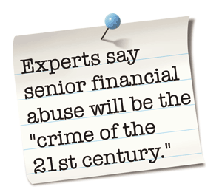
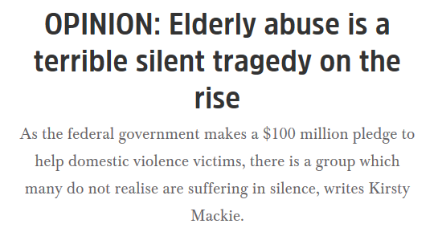
Notes:
The Australian Institute of Family Studies says that between 2% and 10% of older Australians experience elder abuse in any given year, and the prevalence of neglect is possibly higher.
A family member is more likely to commit elder financial abuse, although in cases we have seen, third party carers or others who gain the trust and confidence of elder person can also be perpetrators.

Slide 10
What is financial elder abuse – FOS summary
A third party who directly or indirectly uses the assets of an older person…
…who is vulnerable because of incapacity, or because of misplaced trust or confidence
…which is to the detriment or potential detriment of the older person and to the gain of another person
Notes:
It also helps to distinguish potential financial abuse from an informed decision by an older person with capacity to make a decision, who makes it free from any improper or undue influence from a third party.
It is important to note that vulnerability can arise not only because of incapacity, but also because of dependence on, or trust in, a third party.
Financial elder abuse is a complex area and there are challenges to identifying warning signs where financial elder abuse may be occurring.
On the one hand, elderly people should be able to make genuine transactions without a fuss. On the other hand, sometimes there is the need for a financial institution to ask more questions to ensure that their customer understands the nature of the transaction.

Slide 11
What FOS will consider in a dispute involving alleged financial abuse
When may an FSP be legally liable for a customer’s losses?
Authorisation
Forgery
Incapacity
Notice of undue influence
Unconscionable conduct
Assisting a breach of fiduciary duty
Privacy and confidentiality
Whether the FSP should have made further enquiries
Notes:
An FSP may be liable to reimburse losses to a customer who has been the victim of financial abuse under a number of legal and equitable principles including:
If the customer is unable to read owing to blindness or illiteracy
If the customer’s signature on withdrawal or other transaction documents has been forged
If an unauthorised electronic transaction has been performed and liability is allocated to the FSP under the ePayments Code
If it is on notice of mental incapacity on the part of the customer - FSP staff are entitled to assume an older person has capacity, unless there are indications to the contrary
If it is on notice of undue influence – actual or presumed
If it has, with knowledge, assisted in breach of trust
If it has itself taken advantage of a vulnerable older person so as to have engaged in unconscionable conduct.
The hardest issue is the last one, whether the FSP should have made further enquiries

Slide 12
Financial elder abuse – on the frontline
Staff may have concerns about what they are observing, and have an instinct that something is not right.
However they may be wary about voicing their concerns about a customer being exploited given the suspected exploiter may be a family member.
Notes:
Financial elder abuse often takes the form of misuse of, or theft from, a bank account or other financial services product.
Financial services provider’s (FSP) employees may be in the best, and sometimes the only, position to recognise financial exploitation as it occurs.
This is because older people still prefer to do their banking in a branch where there is more scope to interact with the customer
In disputes we see arising from alleged financial elder abuse, a common claim is that the FSP and its staff should have recognised exploitation was taking place and could have taken steps to prevent loss.
Whether potential exploitation was visible at the time and what could and should have been done are always difficult issues.

Slide 13
The older person may…
be accompanied by a new acquaintance to make a large or unusual withdrawal of cash
not be allowed to speak for themselves, or another party does all the talking
be accompanied by a family member or other person who seems to coerce them into making transactions
start to appear withdrawn or fearful (particularly of the person with them)
Notes:
What are the signs of potential elder abuse?

Slide 14
The older person may…
have withdrawal slips presented by a third party, with their signature on it buy the rest of the slip filled out in different hand writing
have large withdrawals or transfers made on behalf of the older person without prior direct contact from them
give implausible explanations about or appear confused about what they are doing with their money
not understand or be aware of recently completed transactions

Slide 15
The older person may…
have unpaid bills that they should be able to afford to pay eg complain of having no heating despite the fact that they can afford to have it, or that they are being evicted
suddenly register for internet banking when prior financial activity has been branch based and there has been no preliminary contact with the FSP
indicate that mail is no longer being delivered to their home
engage in financial activity that is unusual, erratic or uncharacteristic
be concerned about missing funds or financial service-related documents

Slide 16
What can financial services providers do about it?
Have a conversation with their customers when they believe they may be experiencing financial elder abuse
A conversation is more than asking one question
It may mean having a separate conversation with the customer
If concerns remain, then staff need permission to:
Say “no” or “not yet” to the transaction
Ask to speak to a trusted family member
Refer customers to appropriate support services
Notes:
If the customer is accompanied by someone else, then a useful first step is to separate the customer from that other person and have a separate conversation.
I have deliberately used the word “conversation”.
In one recent case we dealt with the teller though their elderly customer who had regularly banked at the same branch for 30 years wanted to break a term deposit to send $100,000 overseas.
The teller asked what the money was for and the customer replied that it was for a relative. The FSP did not ask any further questions.
A week later the customer came back to transfer another $100,000. When asked he said it was to buy a house in the UK. It turned out he was a victim of a scam.
We took the view the FSP could have had a better conversation given the very unusual nature of the transactions.
This included having a conversation and also contacting a trusted family member.
The applicant’s daughter was noted on the bank’s systems as a Power of Attorney.
The FSP was required to refund the $200,000 to the applicant.

Slide 17
Case study
Case study 1
Mr & Mrs Cannizzo* were in their 90s and although they were not separated, they lived in different nursing homes.
In 2014, they signed a power of attorney providing the Mrs Cannizzo’s daughter and Mr Cannizzo’s son with authority to access online banking to view statements only.
In April 2015, Mrs Cannizzo’s daughter rang the bank to report suspected unauthorised transactions on the account by Mr Cannizzo’s son.
* Not their real names

Slide 18
Case study
Case study 1 (continued)
Five days after Mrs Cannizzo’s daughter reported the suspected unauthorised transactions, Mr Cannizzo’s son took his father in his wheelchair to a bank branch.
Mr Cannizzo closed the joint account and transferred the funds into a different account, in his name only, without Mrs Cannizzo’s daughter’s knowledge.
The closing balance of the joint account was almost $140,000.
Following this, Mrs Cannizzo’s daughter lodged a dispute with FOS.
* Not their real names

Slide 19
Case study
Case study 1 (continued)
Five days after Mrs Cannizzo’s daughter reported the suspected unauthorised transactions, Mr Cannizzo’s son took his father in his wheelchair to a bank branch.
Mr Cannizzo closed the joint account and transferred the funds into a different account, in his name only, without Mrs Cannizzo’s daughter’s knowledge.
The closing balance of the joint account was almost $140,000.
Following this, Mrs Cannizzo’s daughter lodged a dispute with FOS.
We found that the bank had failed to exercise appropriate care in response to a number of ‘red flags’ and that signs of undue influence should have been recognised.
Our determination required that the bank transfer half the funds, plus interest, into an account nominated by Mrs Cannizzo.
* Not their real names
Notes:
Mrs Cannizzo’s daughter said the bank should not have allowed Mr Cannizzo to close the joint account and transfer the funds into his name without her knowledge and consent.
The determination, made in October 2016, said the FSP did not comply with good industry practice to protect the applicant from potential financial abuse.
We said in the determination: ‘An FSP should be able to recognise signs that a customer may be under the undue influence of another party, including where the customer is elderly or vulnerable and conducting an unusual transaction in the presence of another person.’
We identified the ‘red flags’ as:
The unusual nature of the disputed transaction
Mr Cannizzo, who conducted the transaction, was in his 90s, in a wheelchair and accompanied by a person who the bank had been notified may have not been acting in the best interests of both accountholders.
The bank’s notes showed that branch staff considered whether Mr Cannizzo had capacity to conduct the transaction.
We found that the staff should have made inquiries of Mr Cannizzo in the absence of his son, and of Mrs Cannizzo, before closing the account and transferring the funds.
If they had done so, Mrs Cannizzo would most likely not have consented to the transaction.

Slide 20
Case study 2
Roy* attended a branch of an FSP in a rural area with new acquaintance, Nola*, and completed a third party operating authority allowing Nola to operate on his personal account.
Roy and Nola also asked to withdraw $30,000 from Roy’s personal account, however they were told to return at a later date when cash would be available.
Two days later, Roy and Nola returned to the same branch to complete the $30,000 cash withdrawal.
* Not their real names

Slide 21
Case study 2 (continued)
One month later, Roy was admitted to hospital and was subsequently declared incompetent.
A guardian was appointed to administer Roy’s financial affairs.
Nola had left town taking the cash with her.
Roy had never withdrawn such a large amount of cash before and his guardian said he was induced by Nola to change the account operating authority and withdraw the cash.
* Not their real names

Slide 22
Case study 2 (continued)
One month later, Roy was admitted to hospital and was subsequently declared incompetent.
A guardian was appointed to administer Roy’s financial affairs.
Nola had left town taking the cash with her.
Roy had never withdrawn such a large amount of case before and his guardian said he was induced by Nola to change the account operating authority and withdraw the cash.
In these circumstances, the FSP should have:
discussed the transaction with Roy separately from Nola; and
taken steps to identify and protect Roy from potential financial abuse.
The FSP was required to refund the $30,000 back to Roy’s account.
* Not their real names
Notes:
FOS considered the dispute and found the FSP did not comply with good industry practice in relation to the cash withdrawal because Roy:
appeared elderly and dishevelled; and
withdrew a large amount of cash while accompanied by a new acquaintance.

Slide 23
Any questions?

Slide 24
Who we are
Philip Field
Melanie Hallam
GPO Box 3 Melbourne VIC 3001
www.fos.org.au
(03) 9613 7306
pfield@FOS.org.au
GPO Box 3 Melbourne VIC 3001
www.fos.org.au
(03) 9099 2209
mhallam@fos.org.au
Lead Ombudsman – Banking & Finance
Community Outreach Officer

