Slide 1
knowmore Legal Service

Slide 2

Acknowledgment
of Country
I acknowledge the traditional owners of the land
on which we meet today and pay respects to elders past, present and emerging.
I also acknowledge and pay my respects to any Aboriginal and/or Torres Strait Islander people here today
Notes:
Jade

Slide 3
Jade Johnson, Aboriginal Engagement Advisor
Hannah Webster, Lawyer
Danielle Raymond, Support Worker
Linda Burnett, Financial Counsellor
Caitlin Zacharewicz, Community Education and Outreach Coordinator
Notes:
Jade

Slide 4

knowmore is a program of the National Association of Community Legal Centres (NACLC) funded by the Australian government as represented by the Attorney-General’s department.
knowmore is also supported by a grant from the Financial Counselling Foundation.
Image inspired by original artwork by Dean Bell depicting knowmore’s connection to the towns, cities, missions and settlements within Australia.
Notes:
Acknowledgment slide – for all financial counselling presentations
Acknowledge: NACLC, funded by Attorney-General department, grant from Financial Counselling Foundation, Dean Bell artwork

Slide 5

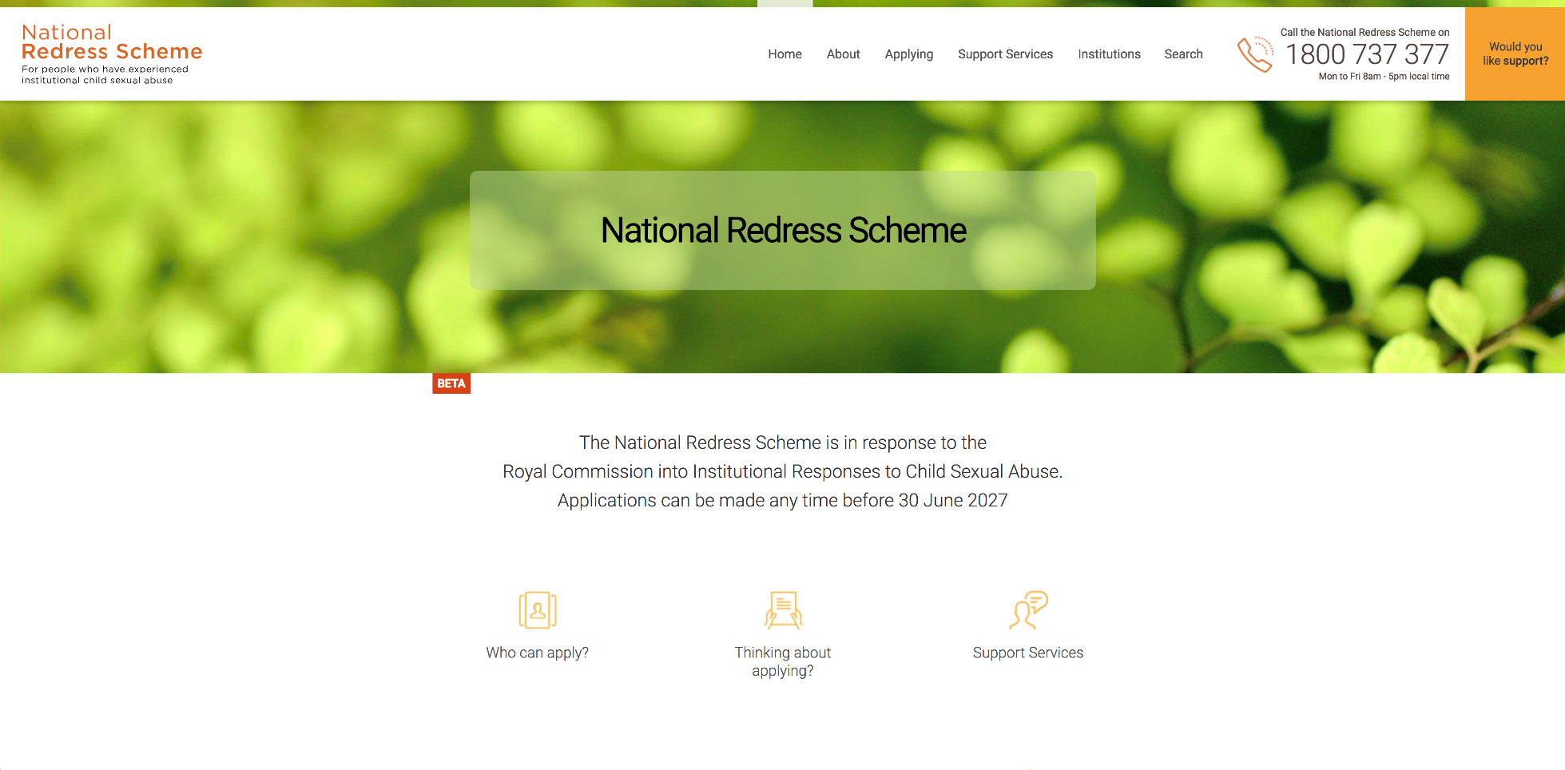
knowmore’s role
www.nationalredress.gov.au
Notes:
Hannah
There was a 5 year Royal Commission. Of the 400+ recommendations, one was the establishment of a NRS. The NRS began on 1 July 2018 with the aim of providing justice to an estimated 60,000 survivors by way of:
Lump sum payment up to $150,000
Counselling
Direct personal response
The application is paper based, but can also be completed online in MyGov. The process usually takes approximately 6-12 months (if the organization has joined the scheme). The amount of the payment is primarily determined by the nature of the sexual abuse.
Knowmore’s role
Free legal advice about all compensation options, including referrals where appropriate to civil lawyers and Redress Supports Services
Legal assistance with NRS applications in some cases

Slide 6

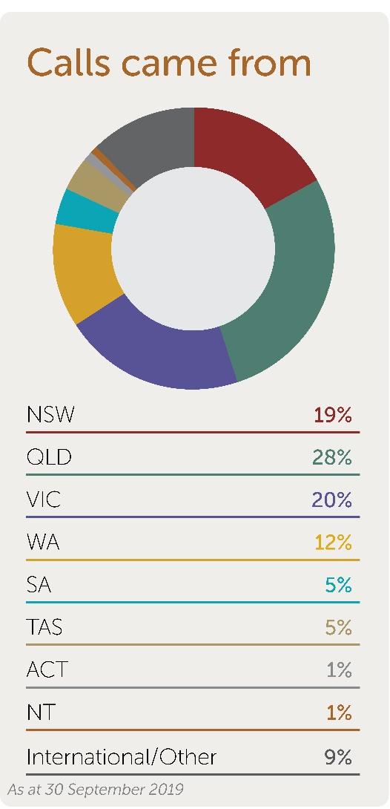
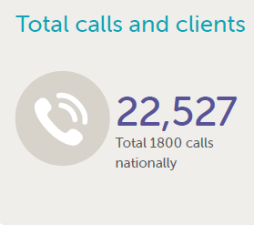
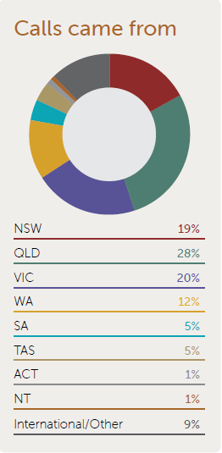
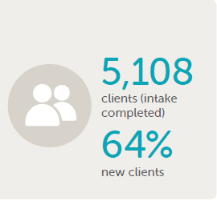
knowmore clients
1 July 2018 – 30 September 2019
Notes:
Hannah
Service snapshot as of 30 September 2019
Tasmanian clients make up 5% of knowmore clients.
1126 calls/enquiries
255 completed intake
Knowmore is committed to outreach in Tasmania. A team has been visiting Tasmania every six weeks, conducting face to face client appointments and meeting with various services.

Slide 7

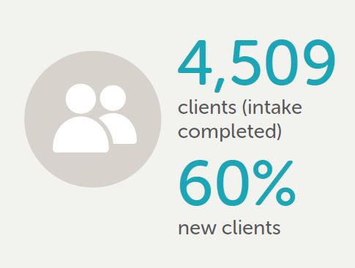
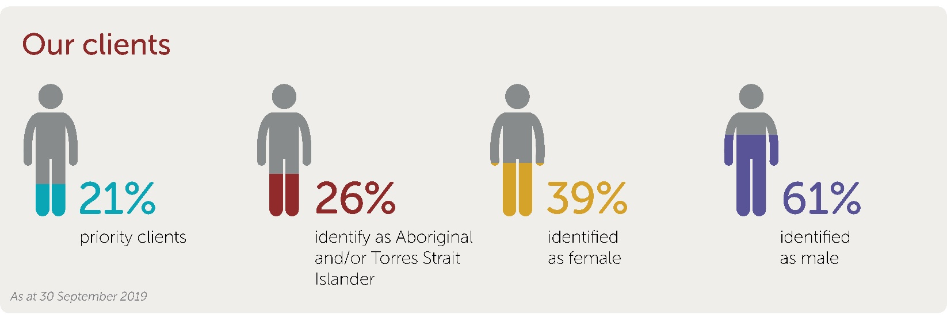
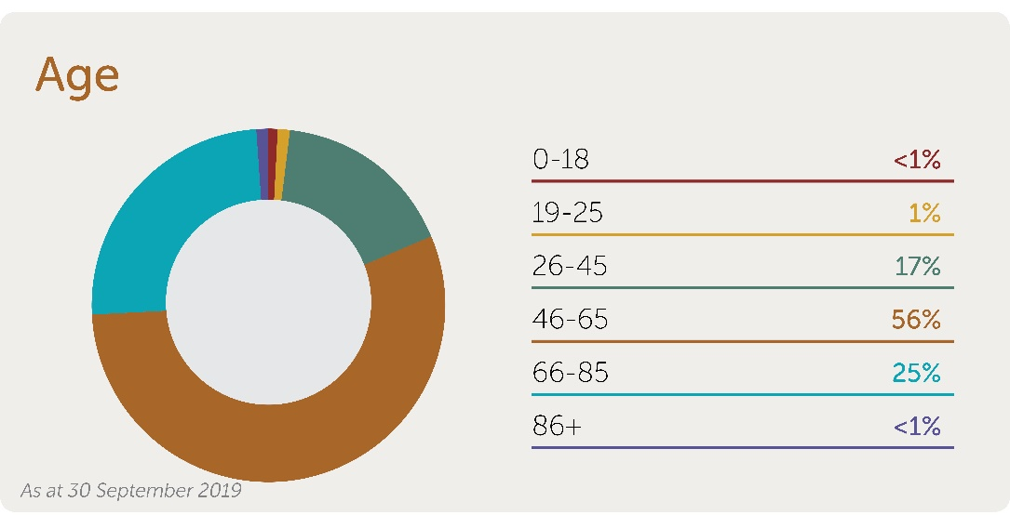
knowmore clients
Notes:
Hannah
Service snapshot as of 30 September 2019
21% of our clients identify as needing priority attention.
26% of our clients identify as Aboriginal or Torres Strait Islander people
39% identified as females and 61% as males.

Slide 8

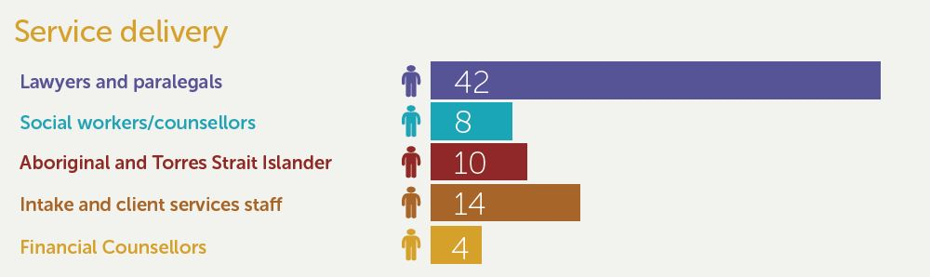
knowmore team update
Notes:
Danielle
Service snapshot as of 30 September 2019
So…what happens when someone makes contact?
Brief description of what happens…
Intake
appointment with lawyer to discuss options a
and we have support services as well.

Slide 9

Financial Counselling
Two year funding from Financial Counselling Foundation to employ 4 FTE financial counsellors in Brisbane, Sydney, Melbourne and Perth
Financial counsellors role can cover:
  addressing existing debts,
  advice on impact of government payment and entitlements,
  managing a lump sum
Notes:
Linda
Knowmore has received funding form Financial Counselling Foundation to employ four FTE Financial Counsellors in Brisbane, Sydney, Melbourne and Perth for two years.
A Financial Counsellor at knowmore:
Discuss their current financial situation – we can work with clients to assist in providing options and advocacy around hardship – pretty similar to generalist FC work, in that they present with a wide variety of hardship and debt issues. Not all of our clients have hardship or debt issues, but when they do we like to assist them before they receive an offer for redress.
Implications of redress payments – we discuss how any redress payment they receive might have an effect on their Centrelink payments, housing etc.
Managing a lump sum – in general, our clients have never had a large amount of money to manage. If they receive a lump sum payment, they can speak to us about the best ways to manage it. We look at ways to protect the money, discuss options for what they might like to do with it and also talk about things like elder abuse and financial abuse by others. Where needed, a referral can be made to a pro bono financial advisor for investment advice. We also talk about wills, and frequently make referrals for a will to be drawn up for the client.
Many clients will not receive the maximum of $150,000. As a FC with knowmore, the primary objective is to assist them with maximizing the benefits of receiving the payment – whether it is by reducing debt levels, advising them of their rights and obligations regarding the payment, or talking with them about the best way to manage the money.

Slide 10
Case Study
Notes:
Linda
I would like to speak a bit about the clients that I work with. Obviously, they have all been through significant childhood trauma and this plays out in their lives in many different ways.
One client that I have been working with said that his education level is about grade 3. His 10 year old daughter reads better than he does. He struggles to find work, and had his house repossessed before I started working with him.
A client that I met last week is being cyber-stalked by her ex-husband. He has accessed her computer and tracked her by her phone, despite there being a 10-year IVO in place. He has taken money from her bank account and also set up credit cards in her name that he has run up debts on. Her biggest worry about accessing a NRS payment is that he may be able to take the money from the bank account. We will be working with her bank to ensure appropriate protections are in place for this money if she does receive a payment. This lady has significant anxiety issues and we have encouraged her to access the support of one of the social workers. In addition to all of this, during the process of applying for redress, she has discovered that she is aboriginal. She has so many questions, and Fiona, one of our Aboriginal Engagement Advisors will be working with her to try to find some answers.
Sometimes the client’s situation is well out of the scope that I am able to work with. There is a client that I have been working with who is living in his car, has major debts and often goes without food. I have had to refer this man out to a local service that can provide some emergency relief as well as a housing service and financial counselling. If he does receive a NRS payment, I am likely to speak with him again around the implications of the payment, but it is in situations like this that I am likely to contact a local FC who can assist the client with a face to face service.
Sometimes the payment can be life changing for clients – one of my clients had been an artist with irregular income all of his life. He is now on the age pension. He received an offer for $80,000. He was able to use this money to pay off the last $40,000 on his home loan, and put away the balance for savings. He said to me that he is set for life now. He owns his home and has a regular income for the rest of his life.

Slide 11

Financial Guide
Notes:
Financial Counselling Guide
We have produced a guide that is available on the knowmore website (under the Financial Counselling tab) that explains the implications of receiving a redress payment. This is a really useful resources for workers that are assisting people applying for redress. It is updated regularly as we learn more about the implications of the redress payments and to include changes to Centrelink.

Slide 12
Referrals to knowmore FC
Referral to knowmore financial counselling via the intake line - phone 1800 605 762
Clients must register as a knowmore client to receive financial counselling
Secondary consults are available regarding lump sum payments
Notes:
Linda
Access to a Financial Counsellor
If you have a client who may benefit from speaking with a financial counsellor, they can contact knowmore via the intake line. The number is 1800 605 762.
For legal reasons, the client would have to be registered as a knowmore client to receive financial counselling.
There is also an option for workers to contact the Financial Counsellors at knowmore for a secondary consult. Please note that Secondary consults are possible ONLY if it is to do with information regarding the lump sum payment.

Slide 13

  Centrelink
    Not income
    Asset
    Gifting
  Commonwealth debt ( Child Support, Centrelink, Tax, HELP)
  State debt (fines)
  Social housing (Public, Community, Aboriginal)
  New bank account
Financial implications of accepting a redress payment
Notes:
Linda
For many of our clients this will be the first time they have ever received a lump sum and for many there will be issues they have to face. Many of our clients receive a DSP, Aged Pension or are on Newstart.
Redress payments are not included as income for Centrelink purposes, but they are regarded as assets. Asset test and deeming rates apply. It is important that Centrelink is notified within 14 days of the amount that has come into their account. This should be recorded by Centrelink as an ‘exempt lump sum’.
Gifting -
Redress Payments are protected from Commonwealth Government Debt Recovery processes (such as Centrelink and tax debts, Child Support and HELP debts). The payments are also protected from State Government debt recovery (such as fines).
NRS Payments are exempt from assets tests in all states for social and public housing, although it does appear that interest earned on the payments will be counted as income when calculating the rent
The single, most important step for a client to take when accepting an offer of redress is to open a new fee free bank account in their own name for the money to be paid into. This will allow the banks to clearly identify the payment and give it the protections that it is entitled to.

Slide 14
  Tax
  Insurance payments
  NDIS
  Prior debts
  Bankruptcy
  Money management
  Economic Abuse
  Will
Other impacts
Notes:
Linda
Not subject to tax
Generally a redress payment will not affect such insurance payments such as Life Insurance, trauma and TPD payments
Redress payments do not affect NDIS
Where clients have existing debt, and before they receive their monetary payment, they should be referred to a financial counsellor, with a view to addressing their existing debts. If this is not done, it is possible that redress payments will be taken to satisfy existing debt.
Redress lump sum payments are not divisible property in Bankruptcy and are therefore protected. It is important for clients to keep a clear record of the lump sum amount to prove that, if they were to go bankrupt in the future, it should not be taken by the trustee in bankruptcy.
Money that is given away (gifted) is no longer protected. Most commonly, this occurs where a person who receives a lump sum, part purchases an asset such as a house and places it in joint names with their partner. The portion of the redress money that has been given away is no longer protected in bankruptcy.
Clients often need assistance with making decisions on what to do with their payment.
The possibility of economic abuse is always present and we speak with clients on ways to protect their payments from those that might be trying to access the funds for themselves.
Where needed, we can refer to pro bono financial advisors. We can also refer clients for pro bono assistance with preparing a will.

Slide 15
Other creditors
Banks and Credit Unions
Insurers (uninsured motor vehicle accidents)
Energy and telcos
Debt collectors
Notes:
Linda
Debts owing to a bank or credit union
Both the banking and credit union sector have voluntarily agreed to take steps to quarantine redress payments from any debt recovery processes. Clients may still want to use their redress payment to pay or settle debts owing to a bank or a credit union and should seek advice from a financial counsellor or community legal centre before doing so.
Third party debts owing to insurers
Suncorp has agreed that NRS payments will be quarantined from debt recovery action and not included in any third-party debts (typically uninsured motorists). Their brands include AAMI, Suncorp, APIA, Bingle, Vero and Terri Scheer (landlord insurance).
Debts owing to other creditors
Other creditors are not prevented from taking legal action to recover debt allegedly owing to them. knowmore and other advocates continue to advocate for agreement by utility providers, telcos and other orgs not to pursue debt recovery action against the redress payment.
Debt collectors – no guarantees. Refer to Recoveries Corp asking if people are going to receive a NRS lump sum payment

Slide 16

knowmore | 1800 605 762 |
fc@knowmore.org.au | knowmore.rog.au
National Redress Scheme | 1800 737 377 |
nationalredress.gov.au
Notes:
Linda
These are the main contacts.
Other organisations have been funded to be Redress Support Service Providers.

Slide 17

Questions?
Notes:
Linda

