Slide 1
Financial Literacy from an Educational Psychology Perspective
Professor Ian Hay
University of Tasmania

Slide 2
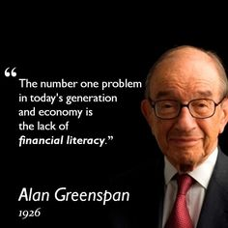
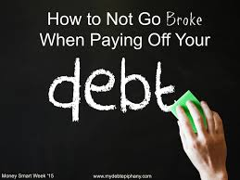
Finances are the 1st reason that students withdraw from college and what gives them the most stress.

Slide 3
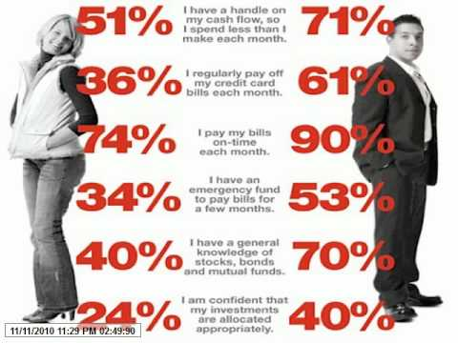
Usa data

Slide 4
The Commonwealth Government funds : Financial Capability services to help people build longer-term capability to budget and manage their money better and make informed choices.
Financial Capability workers deliver financial literacy education, information and coaching and maintain a strong focus on supporting clients to change their behaviour and ‘learn by doing’.

Slide 5
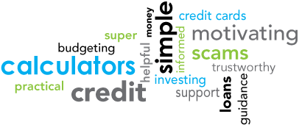
Why is it called Financial Literacy?
Literacy particularly reading is made up of two elements
1 Decoding (Can the person decode the numbers, the text, the behaviour?)
2 Comprehension (Can the person interpret what is occurring, reason & understand it ?)

Slide 6
Money management issues, level 1
Budgeting Saving
Investing
Credit and debt Dealing with credit cards
Managing debt Planning and retirement
Planning for the long term financial future
Ensuring enough money for retirement
Protecting money Choosing appropriate insurance
Understanding rights and responsibilities
Recognising a scam Information and advice
Understanding financial language
Dealing with financial services providers
Getting information about money

Slide 7
Level 2 candidates Australian Data
Despite their self-reported ability,
48% of Australian adults say they do not budget regularly for their day to day finances,
27% have difficulty setting money aside for big purchases or spending and
17% could not get by for some time in case of a financial emergency or an unexpected change of circumstance .

Slide 8
Credit cards and debt candidates level 2 and 3
20% of Australian adults report that they don’t regularly pay off the total balance owing on credit cards
13% say they usually pay only the minimum owing.
17% say that they don’t feel comfortable with their level of debt,
21% will get into debt by buying things they can’t afford
17% pay only the minimum amount owing on loans.

Slide 9
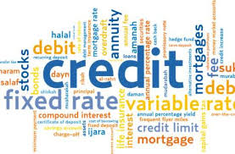
Most common debt
problem is with credit cards
paying electricity accounts

Slide 10
Financial Counselling cycle

Slide 11
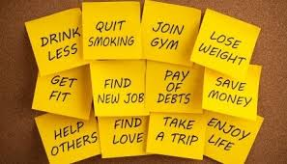
Changing any behaviour is hard
The rewards can out weigh the negatives,
People have wants and the wants are their needs
Others in the home context reinforce the negative behaviour
People selective process information to maintain a standard self identity
People rationalise their actions
The person is unable to manage the situation and the anxiety and so move into flight or fight and do not engage with the problem

Slide 12
There are underlying psychological issue, ie.,people with mild bipolar spend up in the high stage and regret in the low stage
Are bullied and manipulated by others to buy beyond their capacity (elderly abuse, partner abuse and the need for assertive training
Do not believe that the consequences will happen to them (denial)
Show signs of addictive personality disorder
Do not have the cognitive capacity to reason it out
Become fixated with the habit of buying something - high functioning Autism

Slide 13
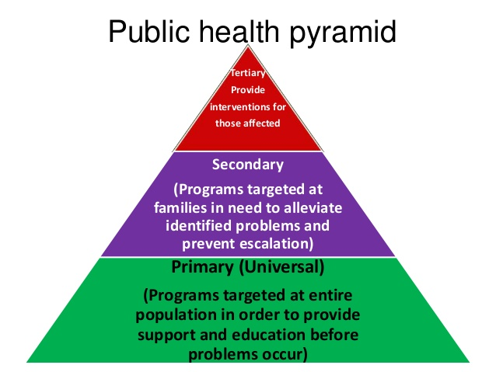

Slide 16
Woks better for primary and secondary intervention

Slide 17
The presenting problem of financial is usually not the full problem,

Slide 18
Not all “help” is helpful

Slide 19
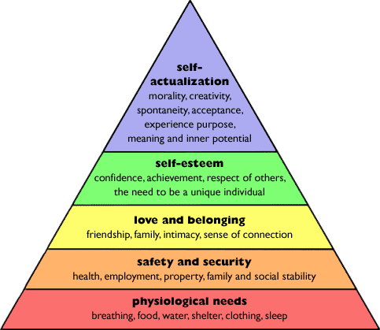
Drivers to spend can occur across the Hierarchy

Slide 20
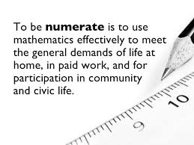
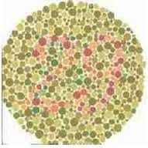
E money is Not tangible requires person to be numerate which is not as common as expected requires ability to deal in the abstract

Slide 21
What Is Cognitive Dissonance? discrepancy between beliefs and behaviors, to dissonance resolved by rationalisation
I know I have limited funds,
but
I am saving money by buying it at this price
I love my children they want this new TV

Slide 22
Teach self-talk:
Do I need it
Can I afford it
Can I do it another way
The last one I still have the need but substitute the solution.
Can not take away the need
I need a holiday but does it have to be the UK

Slide 24
Keep the plan simple and in the here and now Questioning order Avoid why questions, (this avoids the confession and the Guilt) use how questions, make it tangible Then when question put it in a short term time frame first then Who else is involved

Slide 25
Go over the basic steps and get small commitment, set up follow up Keep in the here and now Know your limitations
Have a referral network
You are a member of a number of systems use the systems,

