Slide 1
AFCA update
FCAT Conference
Hobart
31 October 2019
June Smith Deputy Chief Ombudsman jsmith@afca.org.au
Notes:
I would like to acknowledge the Muwinina people (pronounced mou-wee-nee-nar) as the traditional owners and custodians of the land on which we meet today. I pay my respects to Elders past, present and future, and Elders from other communities who may be here today.

Slide 2
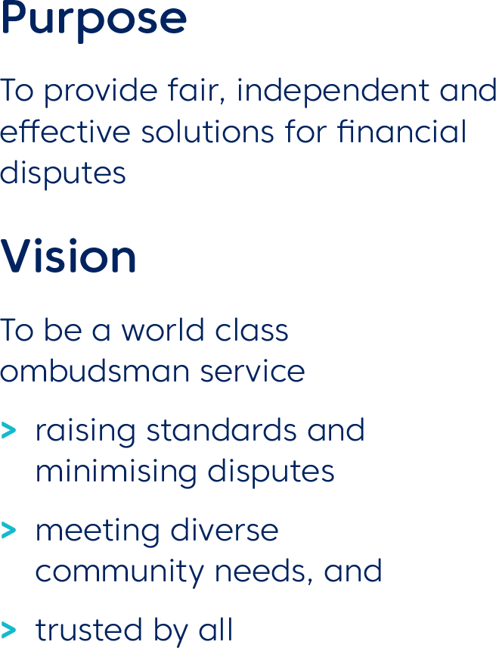
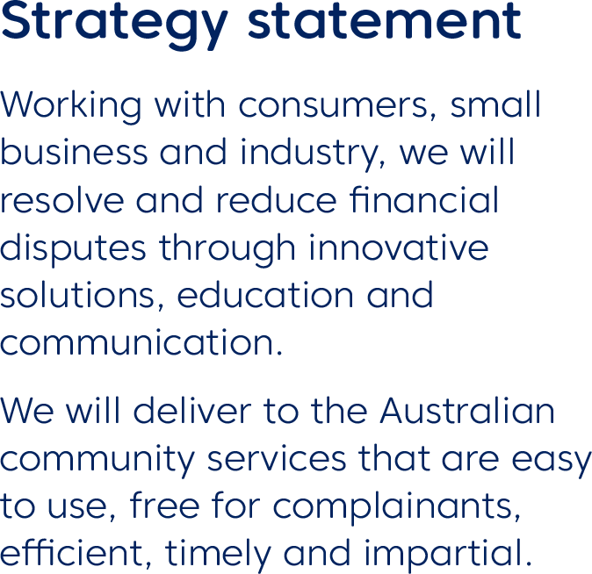
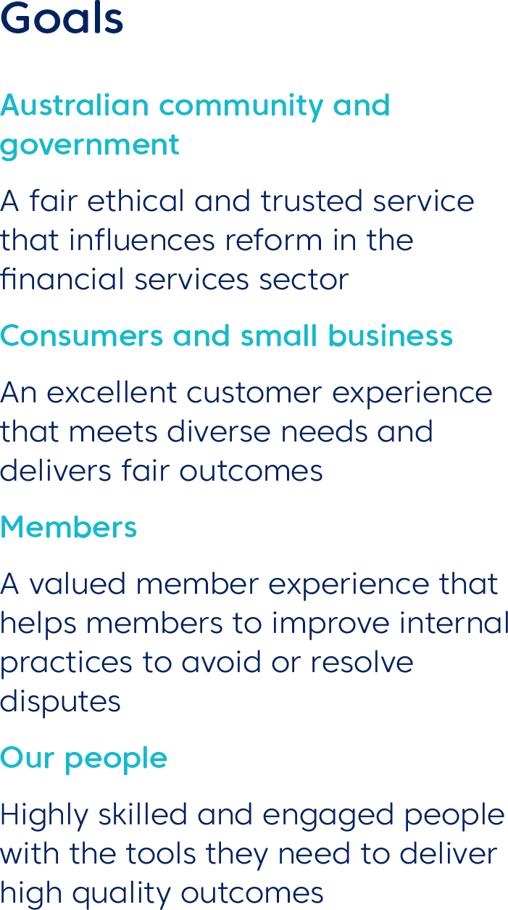
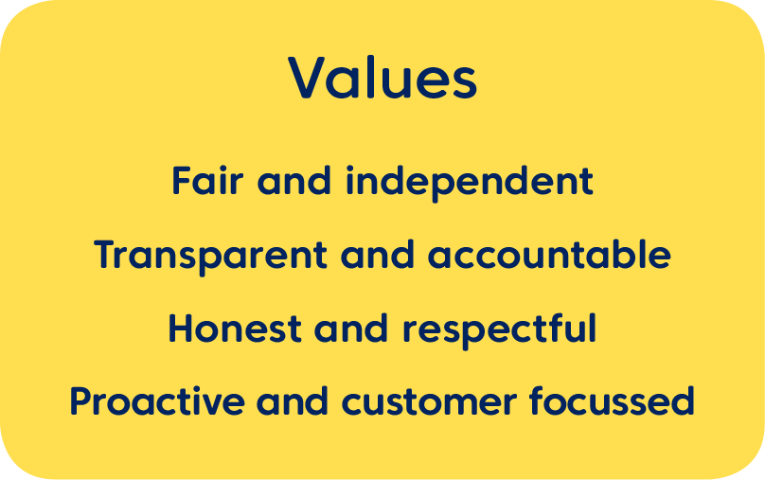
The AFCA strategy

Slide 3
Eleven months at a glance – national statistics
66,739 complaints received
As at 30 September 77% have been closed
$170.24 million in compensation¹
64% resolved in 60 days or less
17% of licensee members had a complaint lodged against them in the first 11 months
¹ This includes matters previously received by AFCA’s predecessor, Financial Ombudsman Service, and resolved by AFCA since 1 November 2018.
*One complaint can have multiple products and issues.

Slide 4
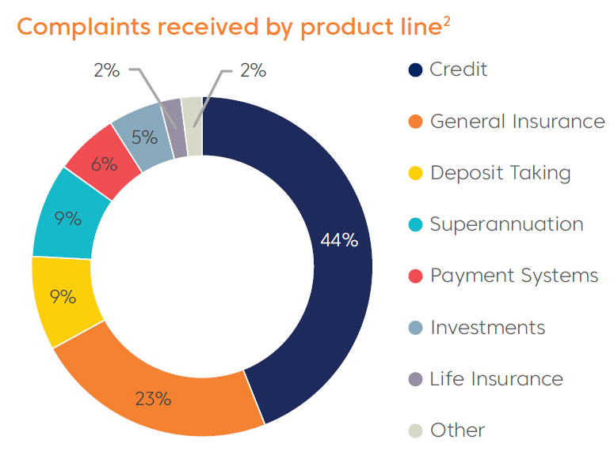
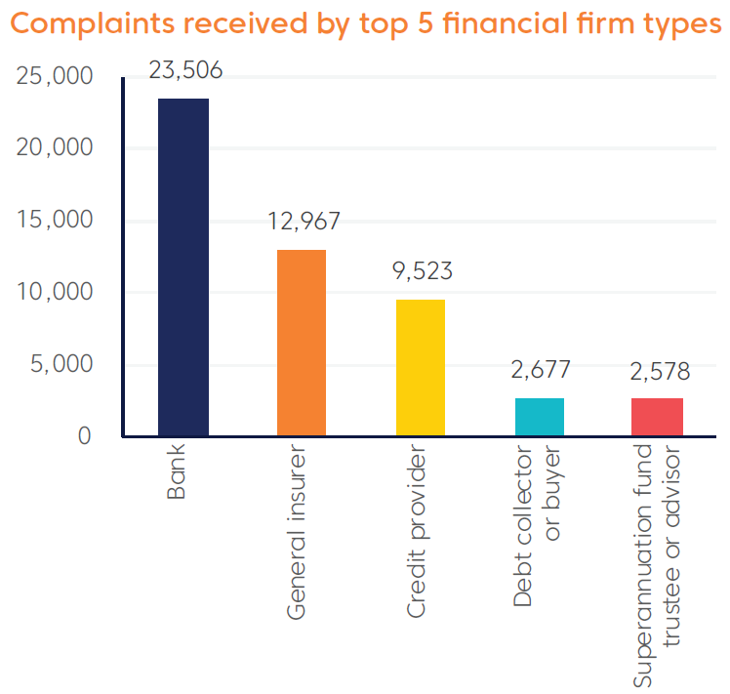
Eleven months at a glance – national statistics
2 One complaint can have multiple product lines.
Notes:
Data and transparency: Our priority is to provide information to consumers, small businesses and financial firms in a way that is accessible and useful.
Working with members: We provide clarity and certainty around the complaint resolution processes and support members to develop and strengthen their own internal processes.
AFCA recognises that we have a significant role in rebuilding trust in the Australian financial services sector.

Slide 5
A sneak peak at our 1 year birthday results…
Since our inception on 1 Nov 2018 we have*:
Awarded or obtained more than $180 million in compensation
Received over 71,000 complaints
7400+ involved financial difficulty
4660+ about credit reporting
2900+ about responsible lending
Resolved or closed over 80% of complaints
Resolved 63% in 60 days or less
Closed 70% by agreement or in favour of complainants
*data as at 29 October 2019

Slide 6
Complaints received from Tasmania
828 complaints received
89 financial difficulty complaints (11% - same as national)
83% closed since 1 November
40 Aboriginal and Torres Strait Islander related complaints (5% - higher than national 2%)
Total compensation awarded or obtained $2.6M

Slide 7
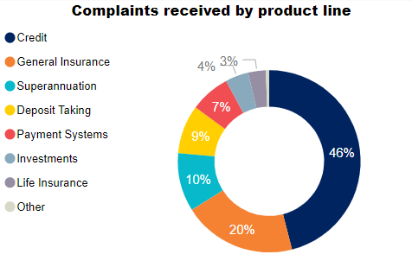
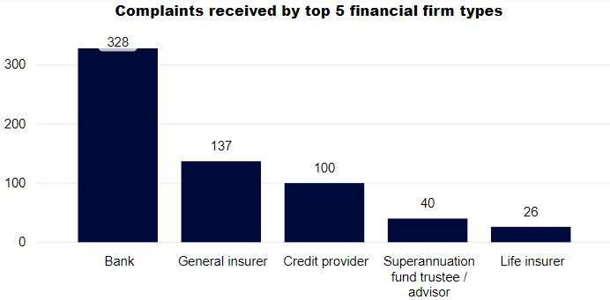
Complaint breakdown – Tasmania

Slide 8
Complaint breakdown – Tasmania
Credit
General Insurance
Issue | Complaints
Credit reporting | 46
Financial firm failure to respond to request for assistance | 33
Responsible lending | 33
Service quality | 26
Unauthorised transactions | 21
Issue | Complaints
Denial of claim – exclusion / condition | 41
Claim amount | 31
Denial of claim | 30
Delay in claim handling | 18
Service quality | 18
Deposit taking
Life Insurance
Issue | Complaints
Unauthorised transactions | 27
Dishonoured transactions | 4
Failure to follow instructions/agreement | 3
Incorrect fees/costs | 3
Mistaken internet payment | 3
Service quality | 3
Issue | Complaints
Denial of claim | 4
Incorrect premiums | 3
Inappropriate advice | 2
Incorrect fees / costs | 2
Denial of claim – exclusion/condition | 2

Slide 9
Complaint breakdown – Tasmania
Investments
Payments systems
Issue | Complaints
Inappropriate advice | 7
Failure to follow instructions / agreement | 5
Failure to act in client’s best interests | 4
Service quality | 3
Incorrect fees / costs | 2
Issue | Complaints
Unauthorised transactions | 15
Denial of claim | 7
Mistaken internet payment | 6
Incorrect fees / costs | 5
Service quality | 4
Superannuation
Issue | Complaints
Incorrect fees / costs | 11
Delay in claim handling | 9
Death benefit distribution | 7
Account administration error | 5
Cancellation of policy | 5

Slide 10
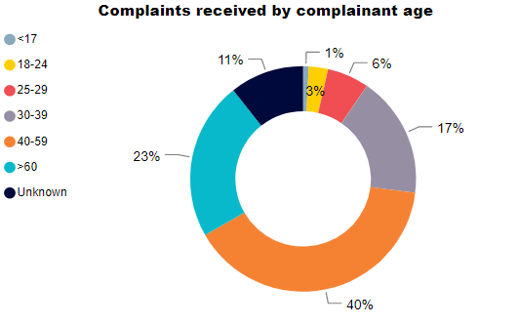
Who lodged complaints in Tasmania

Slide 11
Areas of concern
Growing number of financial difficulty cases
Ensuring awareness of AFCA
Ensuring awareness of legacy jurisdiction back to 1 Jan 2008
Systemic issues and serious misconduct
Members slow to respond to complaints when referred back – timeliness in response to AFCA
Members failing to ensure customers know about EDR (only 1 in 5 are informed at IDR about the ombudsman)
Firm remediation programs – design, reach, approach

Slide 12
Fairness principles
Play by the rules
Keep promises made
Be open and honest
Do not take unfair advantage
Be ethical and professional
Reasonable care and skill
Ensure services are fit for purpose
Protect the money of others
Provide value and benefit
Service the interests of others
Consider consequences and impacts of your actions

Slide 13
Fairness questions
Did the parties obey the law?
Did the parties make promises or representations they did not meet?
Did the parties act honestly, reasonably and in good faith with their dealings with each other?
Did one party take unfair advantage of another? Were specific circumstances or vulnerabilities considered?
Did the financial firm provide the product or service ethically, with reasonable care and skill and in accordance with industry and professional practice?
Did the financial firm meet the consumer’s reasonable expectations about the product or service?
Did the product or service perform as expected and provide a fair value or benefit?
When acting for a consumer, did the financial firm act in the interests of the consumer or group of consumers as a whole?
How did the parties treat each other during their relationship or after concerns were raised?
What was the impact on the consumer and their experience of the service?

Slide 14
AFCA Financial Fairness Roadshow
80+ Locations across Australia
September – November 2019
Tasmania (Hobart, Launceston, Burnie, Devonport)
Victoria
Canberra
Regional NSW
February – April 2020
Sydney
Queensland
Western Australia
South Australia
Northern Territory

Slide 15
Changes ahead
From 1 October publication of all decisions naming financial firms
Publication of Comparative Tables and data set – 7 November
Focus on data analytics and intelligence
Work with Treasury on Compensation Scheme of Last Resort
Roll out of regular consumer advocate forums

Slide 16
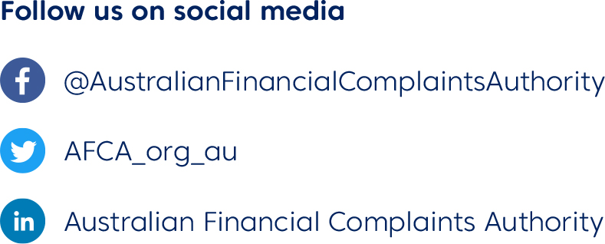
More information

