Slide 1
welcomes delegates to our 2017 conference

Slide 2
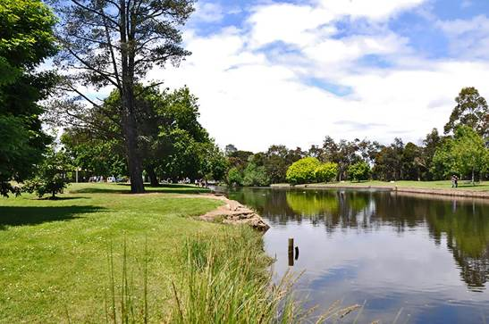

Slide 3
We would like to thank our sponsors

Slide 4
DAY 1 THURSDAY 19TH OCTOBER - MORNING
8.30: REGISTRATION
9.00: CONFERENCE OPENING: Peter Freshney. Mayor of Latrobe
9.05 PRESIDENTS WELCOME: Fiona Moore. FCT President
9.10: KEY NOTE SPEAKER: Peter Freshney Mayor of Latrobe
10.15: MONEY MINDED PROGRAM: Marie Andrews. Financial Counsellor Liaison ANZ
10.30: MORNING TEA
11.00: FCA UPDATE: Fiona Guthrie. Chief Executive Officer FCA, Carmel Franklin Chair FCA Board
11.30: WILLS AND DECEASED ESTATES: Anne Gott. Solicitor Public Trustee
12.30: LUNCH

Slide 5
DAY 1 THURSDAY 19TH OCTOBER - AFTERNOON
1.30: LETTER WRITING TO CREDITORS:
ANZ: Marie Andrews, CREDIT CORP: Laura Pringle,
AURORA ENERGY: Debbie Shearing, CBA: Christina Grygiel
FACILITATOR: Fiona Moore
3.00: AFTERNOON TEA
3.30: CONCURRENT SESSIONS:
1. BANKRUPTCY 101: Fiona Moore Financial Counsellor
2. DEBT OPTIONS: Ross Mackenzie Financial Counsellor
5.00: FINISH
7.00 For 7.30: CONFERENCE DINNER. RSL DEVONPRT

Slide 6
DAY 2 FRIDAY 20th OCTOBER - MORNING
8.30: CHAIR YOGA Christine Hiltner
9.00: IDR/EDR ANZ COMPLAINTS HANDLING PROCESS:
ANZ Customer Advocate Jo McKinstray
9.25: FINANCIAL OMBUDSMAN SERVICE:
Phillip Field Lead Ombudsman Banking and Finance
9.50 CREDIT AND INVESTEMENTS OMBUDSMAN
James Beaumont Senior Manager-Financial Hardship
10.30: MORNING TEA
11.00: CONCURRENT SESSION
1. COUNSELLING SKILLS: Speaker Michelle Knop Program Manager and Educator Life Line Tasmania
2. BOUNDARIES FOR FINANCIAL COUNSELLORS: Andrew Kelly Anglicare Practice Support Unit
12.30: LUNCH

Slide 7
DAY 2 FRIDAY 20th OCTOBER - AFTERNOON
1.30: THE TALK YOU NEED TO HAVE WITH YOUR CHILDREN AND YOUR PARTNER: Phillip Powell
2.00: TASMANIA COLLECTION SERVICE: Katrina de Kaste Business Relationships Manager
2.30: CLOSING REMARKS

