Slide 1
The next generation of MoneySmart
2019 Financial Counsellors Association Tasmania Conference, Hobart
31 October 2019 | Gemma Nicholas
Not for further distribution

Slide 2
Today
What is ASIC doing to build the financial capability of Australians?
What is MoneySmart?
Why are we changing MoneySmart?
Resources and information for financial counsellors
Join our beta testing

Slide 3

About ASIC
ASIC is Australia’s corporate, markets, financial services and consumer credit regulator.
Our vision is for a fair, strong and efficient financial system for all Australians
To realise our vision we will use our regulatory tools to:
  change behaviours to drive good consumer and investor outcomes
  act against misconduct to maintain trust and integrity in the financial system
  promote strong and innovative development of the financial system
  help Australians to be in control of their financial lives.

Slide 4
ASIC’s role in building financial capability
ASIC is the lead Australian Government agency for financial capability, consistent with its strategic priority to promote confident and informed consumers and investors
ASIC's financial capability program includes:
-Leading the National Financial Capability Strategy
-Providing consumer information via ASIC's MoneySmart
-Delivering ASIC's MoneySmart Teaching Program
-Implementing ASIC’s Indigenous Outreach Program.
The National Financial Capability Strategy seeks to broaden the reach and impact of financial capability initiatives that assist Australians to be in control of their financial lives

Slide 5
What is MoneySmart?

Slide 6

What is MoneySmart?
ASIC’s MoneySmart program is part of a nationwide approach to improve financial capability for all Australians
MoneySmart.gov.au offers information for Australians whatever their financial situation
Clear guidance and calculators help people of all ages, backgrounds and incomes to build a better financial life

Slide 7
MoneySmart objectives
Provide simple steps for the 1 in 3 people who feel stressed and overwhelmed by money
Encourage informed use of financial products and services
Increase retirement preparedness
Encourage saving
Provide specialist support for priority audiences
Provide teaching resources for that can be used in Australian classrooms through the MoneySmart education program

Slide 8
What does this mean for people?
General goals
Specific goals
Get help with money
Reduce debt
Plan for the future
Grow wealth
Use calculators
Access publications
Find teaching resources

Slide 9







Slide 10
Why are we changing MoneySmart?

Slide 11

“In 2018, 6.7 million Australians used MoneySmart on 11.6 million different occasions (13% more than 2017), representing an increasing demand for the trusted financial guidance MoneySmart provides” (Google Analytics).

Slide 12
It’s a good time to look at the big picture…
Goal
To increase engagement on MoneySmart (a site which already has great reach)
To set ourselves up for measurable and continuous improvement
To refresh the aesthetics and user experience of MoneySmart and make technical upgrades

Slide 13




Research activities
Engaged with over 1000+ consumers through testing, workshops and research | Conducted qualitative research on how Australians actually use the MoneySmart website | Held workshops with consumers and community/financial services stakeholders | Undertook prototyping and consumer testing

Slide 14



Insights
1 | People rely on online information for making financial decisions | 2 | Experiences with money in early adulthood impact future financial decision making | 3 | MoneySmart is a trusted source of information and Australians appreciate the confidence it gives when researching financial decisions
Notes:
According to Google Trends, in 2018 Australians conducted over 205 million Google searches of generic financial terms (this excludes brand related searches)

Slide 15
What people want from MoneySmart
People value trustworthy information sources and actionable guidance when it comes to their finances
They want to be aware of MoneySmart (or be made aware when they are engaging with other services) and for it to fit into the moments when they need it
They are seeking tailored content, relevant to their lives and believe MoneySmart should be a service that understands their needs today and in the future
They want language that is simple, positive and easy to consume

Slide 16
Sneak peak at the new
MoneySmart

Slide 17
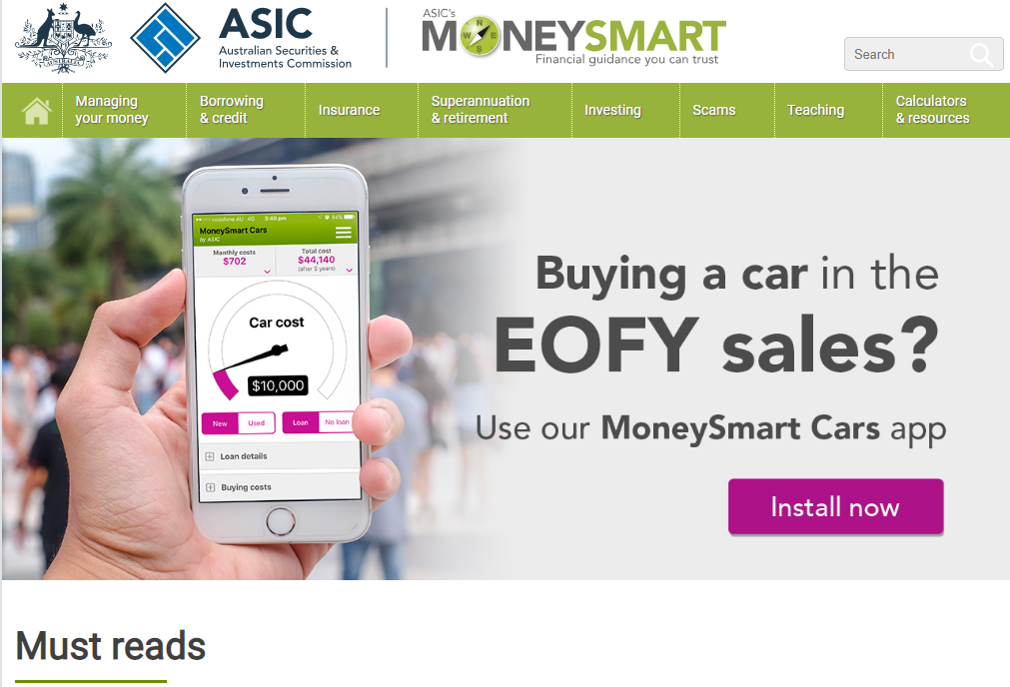
Current home page

Slide 18
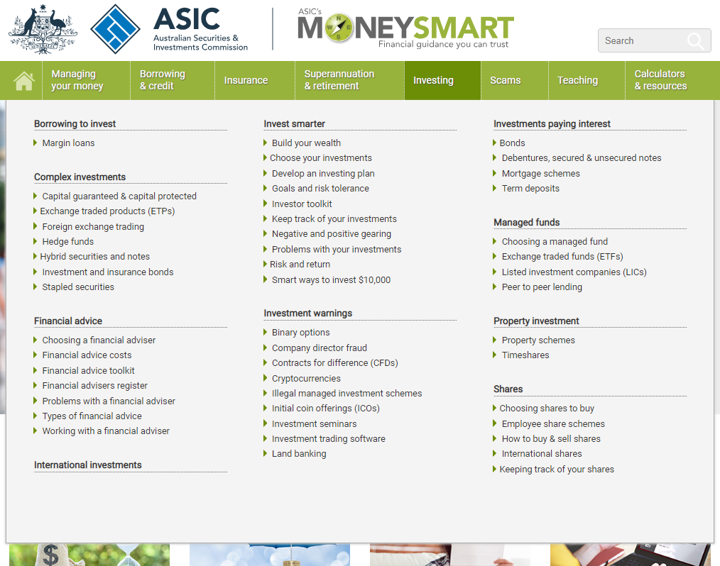
Current mega menu

Slide 19
Key changes
The site aims to provide a starting point for people making a range of financial decisions, not every related piece of information on a topic
MoneySmart has been refreshed with a new logo, design style and tone of voice
The content has been designed to support specific user objectives
There’s a new information architecture and simplified navigation
Certain content is available via search and not the navigation menu.
Notes:
The site aims to provide a starting point for people making financial decisions, not every related piece of information on a topic
MoneySmart has been refreshed with a new logo, design style and tone of voice
The content has been designed to support specific user objectives
There’s a new information architecture and simplified navigation
Certain content is available via search and not the navigation menu.

Slide 20


Slide 21

Our new brand

Slide 22


Slide 23




Slide 24

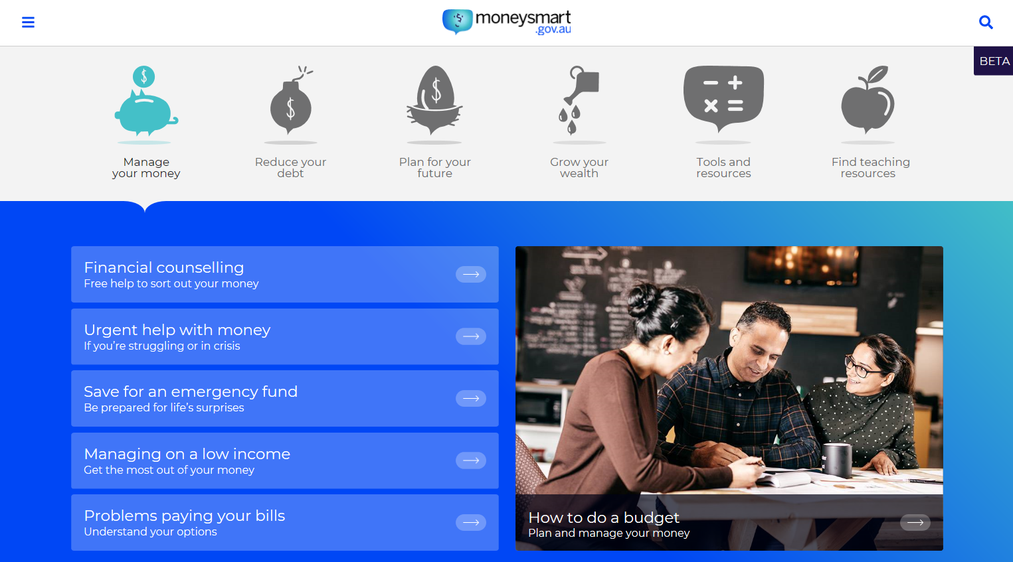
Brand position
Start here
MoneySmart
Website goals
1. Encourage informed use of financial products and services
2. Provide specialist support for priority audiences
3. Provide simple steps for the 1 in 3 who find dealing with money stressful and overwhelming
4. Encourage saving
5. Increase retirement preparedness
Brand pillars
For everyone
For better
For life
Brand personality
Simple
Confident
Independent
Brand purpose
For a better life

Slide 25
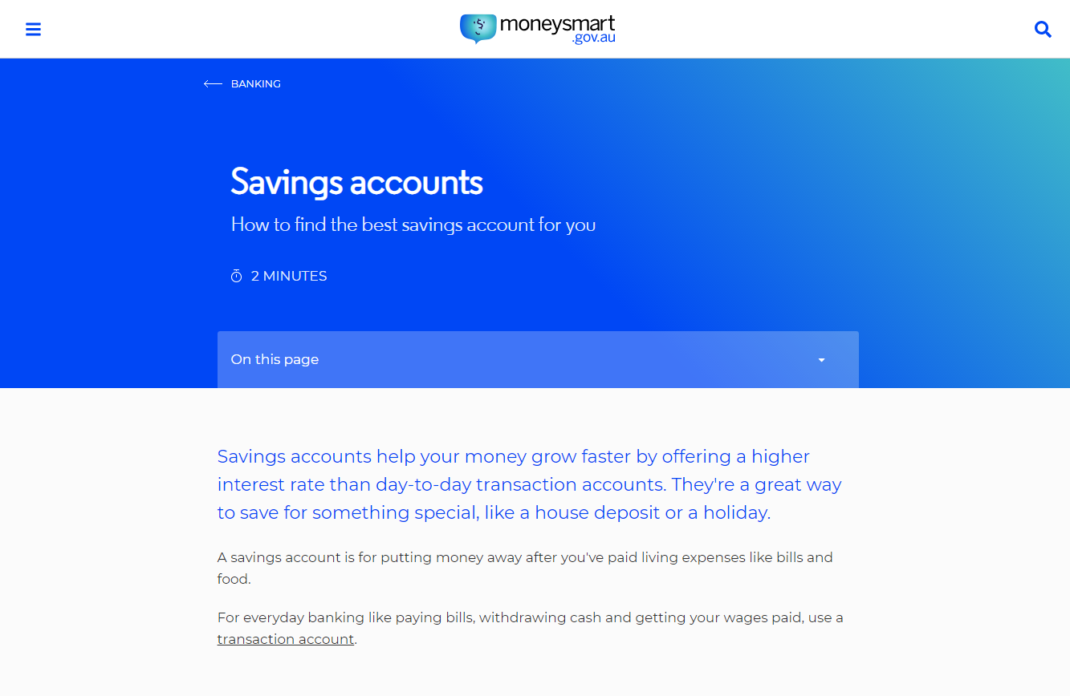

Slide 27


Slide 28


Slide 29
Beyond the main menu
4 out of 5 people who visit MoneySmart land directly on content pages after conducting a Google search
Certain content on the new site is only available via search rather than through the navigation menu
This enables us to provide information that people are searching for without overwhelming visitors to the site with too many options within the navigation.

Slide 30
Hidden content
Searching by single keywords (or tags) will reveal additional content groupings, including pages that are not shown in the main navigation.
Search: seniors
Aged care
Elders and seniors support
Memory loss, dementia and your money
Paying for your funeral
Supporting older Australians
Wills and powers of attorney
Search: kids
Cheap school holidays
Reducing back-to-school costs
Teaching kids about money
Search by topic below for other content pages:
Buying a house
Losing your job
Self-employment
Choosing an accountant
Avoiding sales pressure
Financial abuse
Sending money overseas
Your home
Search: family
Getting married
Getting divorced or separating
Having a baby
Losing your partner
Dealing with illness
Relationships and money
Returning to work after having a baby

Slide 31
Starter packs
Buying a car
Work out a budget
Saving and Investing
Get debt under control
Buying a home
Save for a house deposit
Start a savings plan
Research car loans
Download our cars app
Choosing car insurance
Understanding add-on insurance
Save for an emergency fund
Prepare your budget
Develop an investing plan
Consider exchange traded funds
Contribute to your super
Choosing a home loan
Mortgage calculator
Pay off your mortgage faster
Starter packs are collections of pages that may live in different areas in the navigation menu, but which have a common audience.
These will not necessarily be promoted on the site, but rather will be used as landing pages for campaigns, special projects and social media activity.

Slide 32
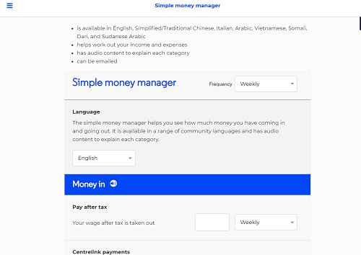
Calculators and planners
Budget planner
Pay day loan calculator
Credit card calculator
Personal loan calculator
Superannuation calculator
Retirement planner
Simple money manager

Slide 33
Publications for financial counsellors
Search “publications” for resources on:
Managing money
Protection against scams
Money management kit factsheet series (for CALD communities)
Borrowing and credit materials (e.g. dealing with debt collectors, urgent help, no/low interest loans, credit factsheet series, helping people in financial difficulty)
Superannuation and retirement publications
Content for Indigenous Australians (e.g. Dealing with book up, paying for funerals, superannuation)
How to complain

Slide 34
Content for financial counsellors
Popular content can be found through the homepage triage tool

Slide 35
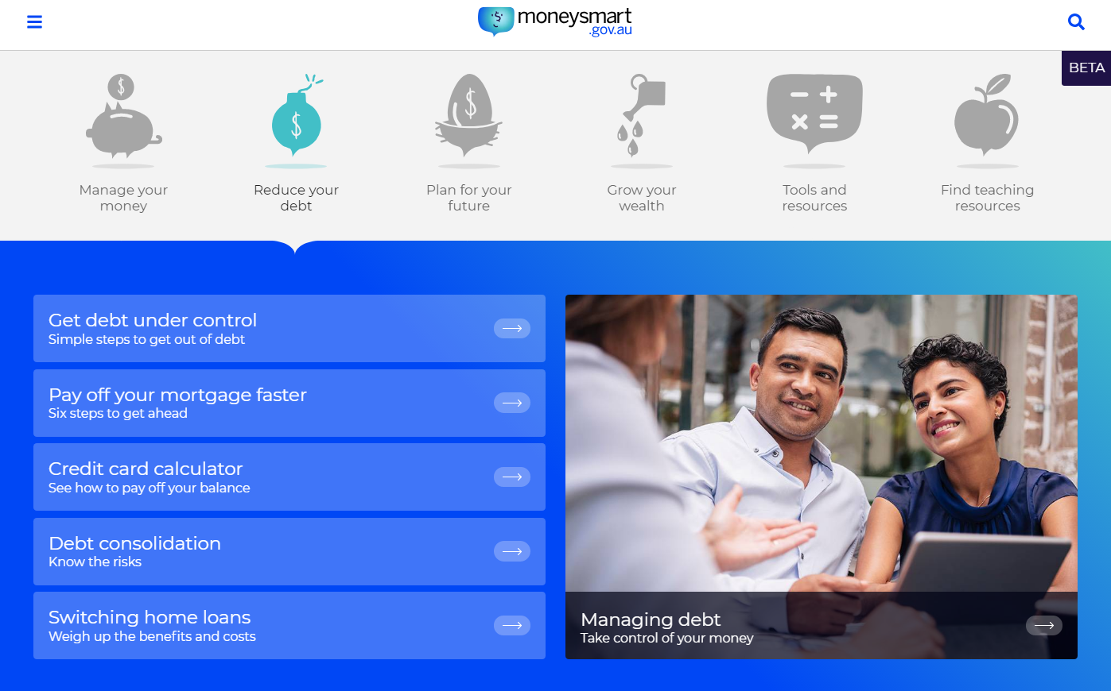

Slide 36
Content for financial counsellors – via navigation
Banking and budgeting | Loans, credit and debt | Insurance | Investments, Super and Retirement
Track your spending Save for an emergency fund Simple ways to save money Banking and credit scams | No or low interest loans Get debt under control Problems paying your bills and fines Dealing with debt collectors | How life insurance works Add-on insurance General information on insurance products (e.g. Home, car, health, trauma) | How to invest Investment scams How super works Grow your super Retirement income Superannuation scams

Slide 37
Aboriginal and Torres Strait Islander people
The Indigenous Outreach Program provides support to Aboriginal and Torres Strait Islander consumers who want to know more about money matters.
The team:
  assist with complaints
  provide copies of our Indigenous educational materials
  provide general assistance and financial literacy education.
Content covers topics including:
  book up
  dealing with family pressures about money
  door-to-door sales
  paying for funerals

Slide 38
Thanks very much!
– any questions?
Gemma.Nicholas@asic.gov.au

Slide 39

Try our beta site…
Click here to access background information on the project and a link to enter the beta version of MoneySmart.
Username: moneysmart
Password: asic
Please note: This is not a public site, so please don’t share the link any further.
Seeking your feedback
We would greatly value your feedback on the new website and have prepared a short survey for your response.
Feedback survey
The survey has a space for general comments, should you wish to provide more detailed feedback. We also welcome extra feedback via return email (gemma.nicholas@asic.gov.au)
Please provide feedback by COB on Thursday 14 November.

